Slide 1



@UK_NEQAS
Annual Participant’s Meeting 2018

Slide 2


Director: Dr Tracey Rees
Manager: Deborah Pritchard
Operations Manager: Amy De’Ath
Deputy Scheme Manager: Melanie Bartley
Healthcare Scientist Practitioner: Geraint Clarke
UK NEQAS Officers: Luke Gardner & Lucy Palmer

Slide 3
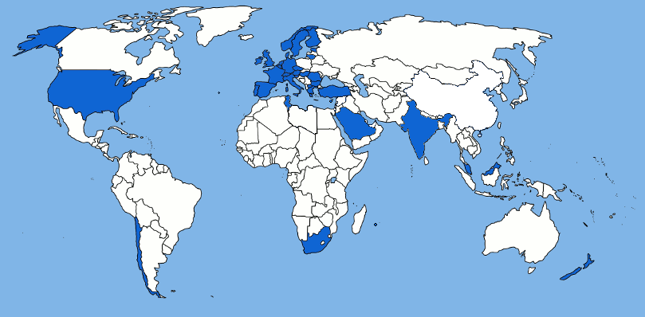
UK NEQAS for H&I: An Overview
Over 350 participants
Distribute to over 52 countries worldwide

Slide 4
Welcome and Introduction
Judith Worthington
Chair of UK NEQAS for H&I Steering Committee

Slide 5
2018 Steering Committee
Judith Worthington (Chair)
Arthi Anand
Patrick Flynn
James Kelleher
Anthony Poles
Ruhena Sergeant
John Smith – retired November 2018
Helena Lee (BSHI Representative to UK NQAAP)
Edwin Massey/Rommel Ravanan (Clinical Representative)
Kathryn Robson (Expert Advisor Scheme 5B)
Alan Balfe (Expert Advisor Scheme 5B)
Gavin Willis (Expert Advisor Scheme 5B)

Slide 6
Notes
Presentation focus on performance, interesting trends, discussion points, changes for 2019
Further detail on Schemes in handouts/available on NEQAS website
Labs 1-100 are from the UK and Ireland (UK&I)
Labs 101 + are from the rest of the world (RoW)
Please ask questions!

Slide 7
Scheme Assessment
Most Schemes assessed on a consensus basis using a 75% consensus level i.e. 75% of reports must agree on a result for it to be assessed
Reference typing results are used for typing/disease schemes if consensus not reached and any educational schemes
  e.g. Scheme 8: HLA Genotyping for Coeliac and Other HLA Associated Diseases and Scheme 4A1: HLA Typing at 1st Field Resolution - DPB1 assessment using a reference result
Equivocal result only accepted for Scheme 2B
All Not tested (NT) results excluded from assessment
Labs that fail to return results, or provide valid reason for NT are assessed as unacceptable

Slide 8
Unsatisfactory Performance (UP)
Each scheme has minimum annual performance criteria
  HLA Typing schemes 90%
  Crossmatching 85%
  Disease Association Schemes 100%
  Antibody Specificity 75%
  Antibody Detection 80%
Participants that do not meet the minimum criteria are classed as unsatisfactory performers
Must complete a root cause analysis and CAPA form

Slide 9
Changes for 2019
Steering Committee
  Tim Clench and Marian Hill (Expert Advisor Scheme 5B)
  John Smith Retired
  Helena Lee replaced by Elizabeth Wroe
NEQAS Operations Manager covering maternity leave
Financial year operation has been implemented
The ‘Participant’s Portal’ bespoke EQA IT system has been introduced

Slide 10

Participant’s Portal
“Thank you for implementing this new on-line system for EQA.
I found it easy and logical to navigate.”

Slide 11
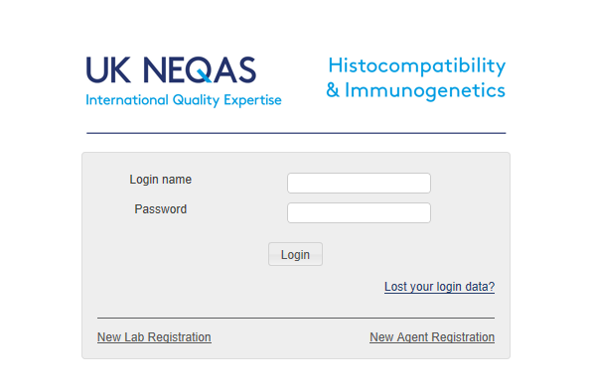
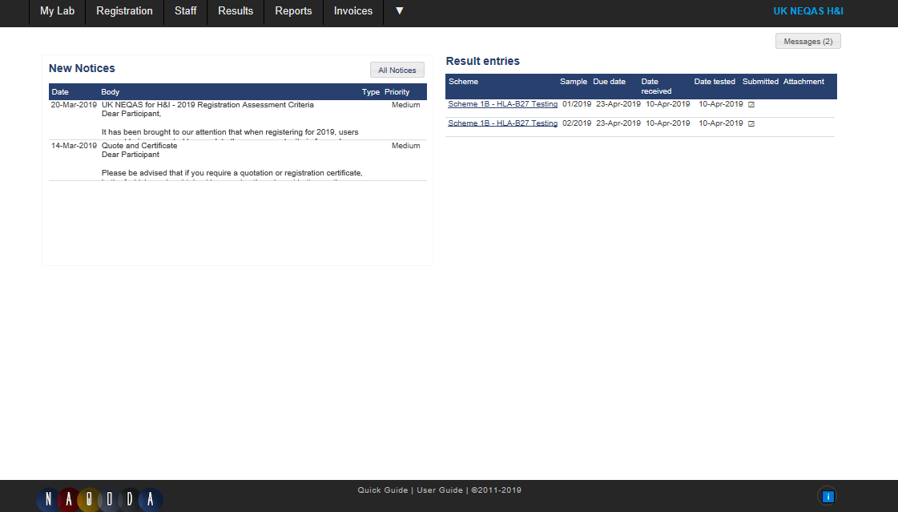
Participant’s Portal
A link to the system can be found on the UK NEQAS for H&I webpage (https://neqas.welsh-blood.org.uk) or by going directly to the portal website https://ukneqashandi.naqoda.cloud
Note: users will automatically be logged
out of the system after 60 minutes of inactivity.
Ensure any work, e.g. results entry is saved or
submitted to prevent loss of data.
Note: The System User Guide and the ‘Quick Guide’ are available in the footer section

Slide 12
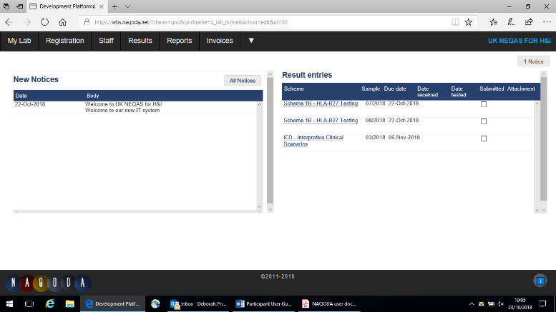
Participant’s Portal
New notices from UK NEQAS for H&I are displayed on the homepage when a user logs in to the system
Notices may contain important information so please read them regularly and mark as ‘read’ when finished
Click on a notice to mark it as ‘read’ and remove it from the homepage.
To view previously read notices click on All Notices

Slide 13
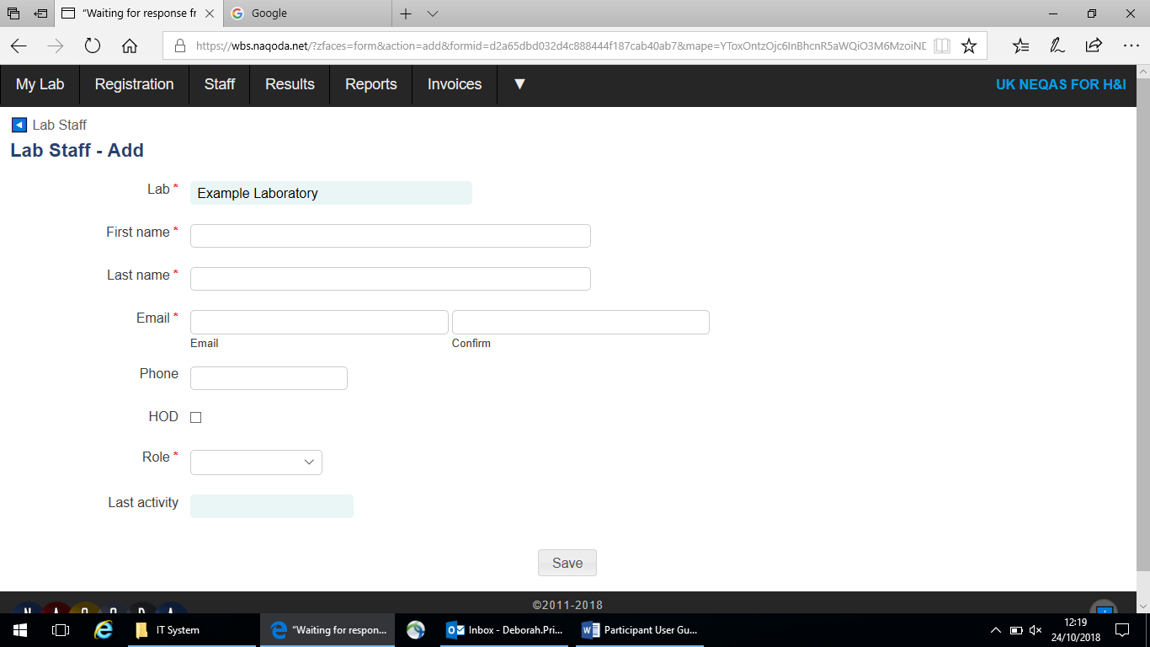
Participant’s Portal: Users
Click on the Add button in the top right corner of the ‘Lab Staff’ page
Complete the required name and contact information and select the relevant user role
Click save and the staff member will be sent an e-mail detailing how to access the system
 | Participant System Function
User Role | Administer Registration/Scheme assessment criteria | Manage Users | Enter results | View reports | View Invoices
Primary User |  |  |  All Schemes |  All Schemes | 
Scheme User | × | × |  Assigned Schemes only |  Assigned Schemes only | ×
Report Recipient | × | × | × | Assigned Schemes only | ×

Slide 14
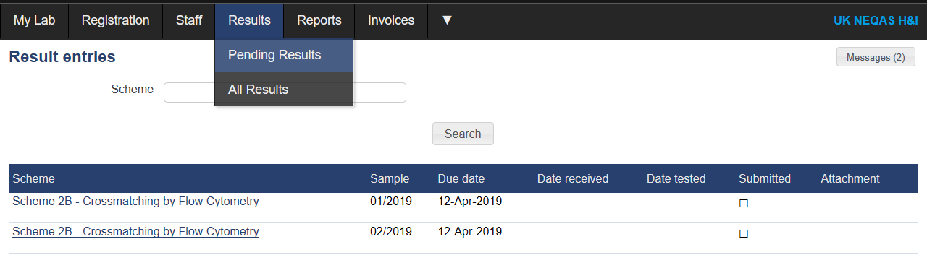
Participant’s Portal: Result Entry
Only Primary Users or Scheme Users linked to relevant scheme can enter results
To enter results, select Results > Pending Results, samples that have results due/open for entry will be listed here
Ensure you do not click on the highlighted Scheme name as this will take you to a summary of submitted results
If relevant, the system will show you what assessment criteria you have chosen - this can be edited if incorrect in Registration > Scheme Entries
Completion of selected assessment criteria is mandatory, denoted by *
Only selected criteria will be assessed, however, other data can be entered for information only

Slide 15
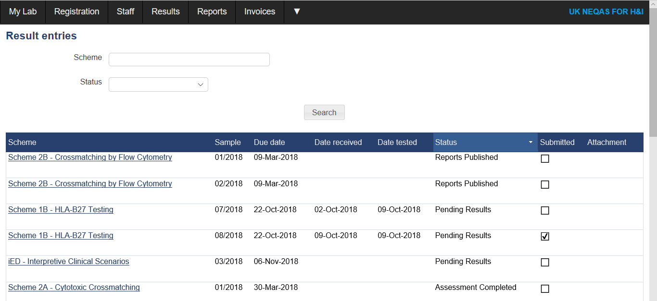
Participant’s Portal: Result Entry
Method Pages
  Complete your laboratory testing methods by completing the methodology questions. This only needs to be completed once, you can then skip to results entry on subsequent samples.
View/Save/Print Entered Results
  Select Results from the main menu and Pending Results or All Results.
  Click on the blue highlighted scheme name in the ‘result entry’ tables.

Slide 16
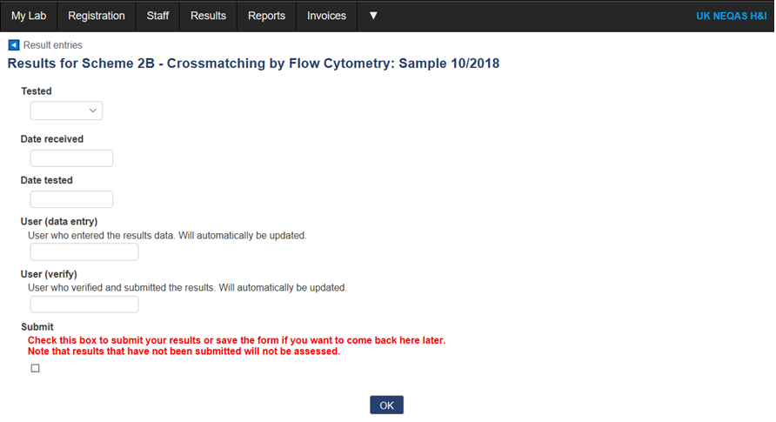
Participant’s Portal: Result Submission
Enter here if results were not tested and include a reason
The User that completes the initial data entry will be named here:
The User that ticks the “Submit” box will be named here:
If the initial User ticks the “Submit” box, they will be named in both fields
If verification is required by a second staff member, leave the “Submit” button unticked and press “OK”
When satisfied with the results, the second staff member can tick the “Submit” box to show verification has been completed, then press “OK”
Results can be amended up until the deadline
A reminder will be issued 2 days before the deadline
PLEASE NOTE: results must be formally submitted in order to be assessed. Failure to tick the “Submit” box before the deadline will result in Unsatisfactory Performance.

Slide 17
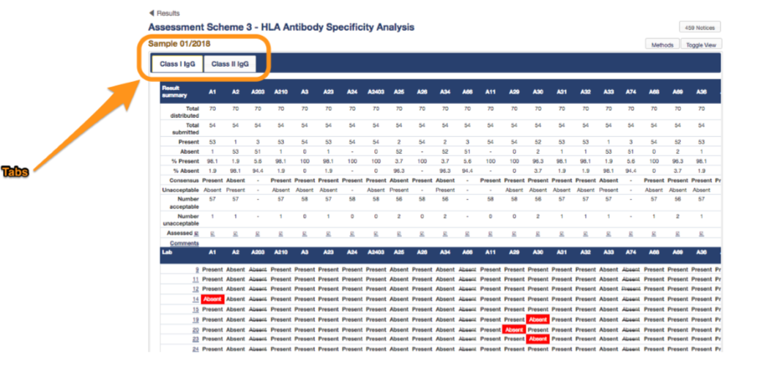
Participant’s Portal: View Assessed Results
To view result summaries tables, select Reports > Performance Tables
PLEASE NOTE: all samples are separate entries in the system, even if in the same batch/distribution
The summary tables will highlight your lab
If you wish to know your lab ID this can be found in the My Lab menu

Slide 18
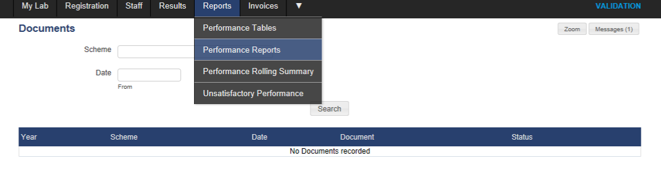
Participant’s Portal: View Assessment Reports
Once assessment of samples is complete notification will be sent that your report is available to view in the Participant System.
Click on Reports and Performance Reports to access all laboratory reports.
The table will display a list of available distribution reports. Unsatisfactory performance notifications, close-out letters and annual performance reports will also appear in this list.

Slide 19
Participant’s Portal
Please come and see us during breaks for specific questions

Slide 20
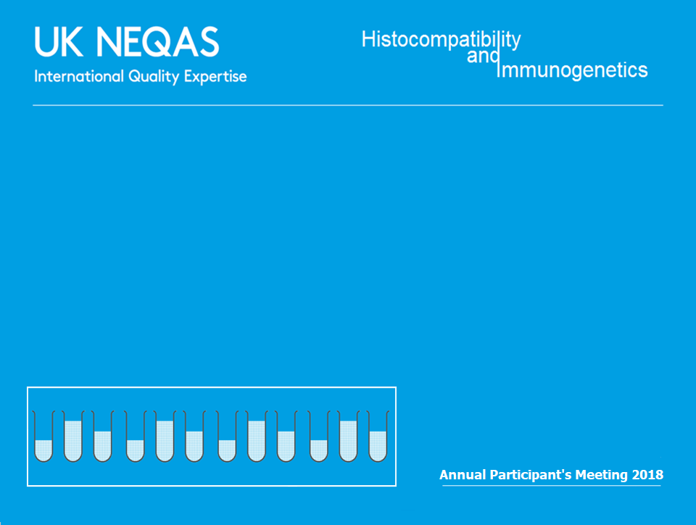
Scheme 2A
Cytotoxic Crossmatching

Slide 21
Scheme 2A
Purpose: To assess participants’ ability to correctly determine cell/serum cytotoxicity crossmatch status
10 blood samples and 40 serum samples sent in five distributions
Consensus: determined by at least 75% agreement on a positive or negative result
Satisfactory Performance: Making 85% of reports in agreement with the consensus result in a distribution year for each cell/DTT type.

Slide 22
Scheme 2A Performance
16 Unsatisfactory Performers (7 UK & Ireland)
All cells with and without DTT | 2015 +DTT | 2016 +DTT | 2017 | 2018
Number of Participants (UK&I) | 64 (18) | 64 (18) | 75 (19) | 71 (18)
Number with Unsatisfactory Performance (< 85%) (UK&I) | 9 (0) | 13 (6) | 16 (6) | 16 (7)
% Unsatisfactory Performance (UK&I) | 14.0% (0%) | 20.3% (33.3%) | 21.3% (31.6%) | 22.5% (38.8%)

Slide 23
UK&I 2018 Performance
 | PBL | PBL +DTT | T Cell | T Cell +DTT | B Cell | B Cell +DTT
Crossmatches assessed (n=40) | 37 | 38 | 34 | 39 | 23 | 33
% NT | 7.9% | 8.3% | 6.8% | 12.0% | 14.7% | 19.3%
NT | 19 | 20 | 41 | 72 | 100 | 131
% incorrect assignments | 5.0% | 1.3% | 6.9% | 2.9% | 13.0% | 5.9%
False Positive | 10 | 2 | 35 | 17 | 41 | 33
False Negative | 1 | 1 | 0 | 0 | 10 | 0

Slide 24
Unacceptable Performers 2018
 | PBL -DTT | T -DTT | B -DTT | PBL + DTT | T + DTT | B + DTT | Lab Identified Error
25 |  |  | 82.6% |  |  |  | Cell viability
34 |  |  | 56.5% |  |  |  | Cell viability
38 |  |  | 78.3% |  |  |  | Unclear
39 |  |  | 75.0% |  |  |  | Cell viability
41 |  | 79.4% |  |  | 84.6% | 75.8% | Waiting for a response
51 |  |  | 78.3% |  |  | 84% | Cell viability
54 |  |  | 81.3% |  |  | 84% | Technical issues and cell viability
112 | 40% |  |  |  |  |  | No response
193 |  |  | 77.8% |  |  | 81.8% | No response
197 |  | 69.6% | 64.3% |  | 66.7% | 78.9% | No response
252 |  |  | 81.8% |  |  |  | No response
292 |  |  | 83.3% |  |  |  | Cell viability
293 |  | 0% | 0% |  | 0% | 0% | Cell viability (transport)
351 |  | 0% | 0% |  | 0% | 0% | No response
406 | 0% | 0% | 0% |  |  |  | No response
411 |  | 63.2% | 50.0% |  | 66.7% | 55.6% | No response

Slide 25
Cell Viability Issues
Labs reporting issues with B cell viability or count
Key: Blue denotes B cell results were not submitted, green denotes B cell results were submitted, purple denotes some B cell results were submitted
2A Sample | UK&I Labs | % With an Issue (n=17) | RoW WB % With an Issue (n=18) | RoW PC % With an Issue (n=36)
01 | 9, 45, 54, 58 | 23.5% | 16.7% | 27.8%
02 | 9 | 5.9% | 16.7% | 25.0%
03 | 9, 34 | 11.8% | 27.8% | 13.9%
04 | 9, 20, 34 | 23.5% | 27.8% | 5.6%
05 | 9, 11, 12, 39, 51 | 29.4% | 22.2% | 16.7%
06 | 9, 11, 12, 24, 28, 39, 51 | 41.2% | 11.1% | 27.8%
07 | 51 | 5.9% | 5.6% | 41.7%
08 | 9, 11, 24, 28, 51, 54 | 35.3% | 27.8% | 36.1%
09 | 9, 25, 28, 38, 42, 51, 54, 58 | 47.1% | 22.2% | 38.9%
10 | 9, 24, 28, 42, 51, 54 | 35.3% | 16.7% | 33.3%

Slide 26
Cell Viability Issues
2018 | 2A01 | 2A02 | 2A03 | 2A04 | 2A05 | 2A06 | 2A07 | 2A08 | 2A09 | 2A10
 | Bcells | Bcells | Bcells | Bcells | Bcells | Bcells | Bcells | Bcells | Bcells | Bcells
9 | 80 | 70 | 90 | 60 | 60 | 60 | 70 | 60 | 70 | 60
11 | 75 | 60 | 70 | 70 | - | - | - | - | 65 | 50
12 | 85 | 90 | 75 | 85 | 60 | 70 | 95 | 95 | 95 | 98
20 | 95 | 80 | 80 | 40 | 90 | 90 | 85 | 85 | 90 | 90
23 | 90 | 90 | 80 | 30 | 80 | - | 80 | 80 | 80 | 90
24 | 90 | 90 | 90 | 95 | 80 | 70 | 95 | 90 | 95 | 95
25 | 99 | 99 | 95 | 99 | 99 | 99 | 100 | 100 | 40 | 99
28 | 85 | 95 | 99 | 85 | 80 | 50 | 90 | 65 | 20 | 60
34 | 90 | 90 | 80 | 85 | 85 | 85 | 80 | 80 | 97 | 97
38 | 85 | - | 85 | 97 | 85 | 87 | 90 | 80 | - | 85
39 | 98 | 98 | 95 | 90 | 100 | 100 | 90 | 90 | 98 | 98
41 | 90 | 95 | 90 | 90 | 98 | 90 | 95 | 90 | 90 | 90
42 | 95 | 90 | 95 | 85 | 95 | 85 | 90 | 95 | - | 90
45 | 80 | 85 | 95 | 90 | 85 | 85 | 85 | 85 | 80 | 90
51 | 90 | 90 | 95 | 90 | 80 | 90 | - | - | 90 | 90
54 | 50 | 80 | 95 | 85 | 95 | 80 | 95 | 80 | 60 | 70
58 | 20 | 90 | - | - | 85 | 85 | 90 | 90 | 20 | 95
101 | - | - | 99 | - | - | - | - | - | - | -
114 | - | - | 95 | 70 | - | - | - | - | - | -
116 | 45 | 55 | - | - | 50 | 80 | 85 | 90 | 95 | 95
117 | - | - | - | - | - | - | - | - | - | -
136 | 95 | 98 | - | 80 | 95 | 95 | 99 | 85 | 98 | 98
145 | 80 | 80 | 90 | - | 100 | 90 | 100 | 100 | 100 | 100
149 | - | - | 100 | 100 | - | - | - | - | - | -
162 | 45 | 100 | 99 | 98 | - | - | 100 | 100 | 90 | 100
181 | 100 | 100 | 95 | 99 | 90 | 92 | 95 | 85 | 100 | 100
186 | 99 | 99 | 80 | 95 | 99 | 99 | 99 | 99 | 99 | 99
204 | 80 | 80 | 60 | 90 | 80 | 85 | - | - | 90 | 90
206 | 100 | 100 | 15 | 50 | 80 | 80 | 90 | 85 | 90 | 90
223 | 70 | 45 | 90 | 90 | 50 | 50 | 95 | 90 | 20 | 20
227 | 98 | 98 | - | 80 | 98 | 90 | 98 | 98 | 90 | 90
268 | 90 | 90 | 80 | 85 | 85 | 80 | 80 | 90 | 90 | 80
284 | 85 | 95 | - | - | 97 | 97 | 90 | 90 | 60 | 50
311 | 95 | 80 | - | 80 | 90 | 90 | 70 | 60 | 80 | 80
315 | - | 80 | - | - | 80 | 80 | - | - | 80 | 80
351 | - | - | - | - | - | - | 80 | 80 | 90 | 90
406 | - | - | - | - | - | - | - | - | - | -
411 | - | - | - | - | 70 | 65 | - | - | - | -
415 | - | - | - | - | - | - | 60 | 60 | 70 | 65
Participant reports of B cell
viability for Scheme 2A:
Average UK&I 83%
Average RoW 85%
Key (UK&I only):
Pink highlight any report of <90 cell viability,
Red labs reported more than 5 issues with B cells,
Orange labs reporting more than once on issue with B cells,
Yellow labs reporting one issue with B cell viability/count.

Slide 27
Cell Viability Issues
Participant reports of cell viability for Scheme 2A in comparison to comments regarding poor viability and results submitted:
Labs | % Viable B Cells Reported by UK&I Labs
 | 1 | 2 | 3 | 4 | 5 | 6 | 7 | 8 | 9 | 10
9 | 80 | 70 | 90 | 60 | 60 | 60 | 70 | 60 | 70 | 60
11 | 75 | 60 | 70 | 70 |  |  |  |  | 65 | 50
12 | 85 | 90 | 75 | 85 | 60 | 70 | 95 | 95 | 95 | 98
15 | 99 | 99 | 80 | 100 | 80 | 90 | 99 |  | 90 | 90
20 | 95 | 80 | 80 | 40 | 90 | 90 | 85 | 85 | 90 | 90
23 | 90 | 90 | 80 | 30 | 80 |  | 80 | 80 | 80 | 90
24 | 90 | 90 | 90 | 95 | 80 | 70 | 95 | 90 | 95 | 95
25 | 99 | 99 | 95 | 99 | 99 | 99 | 100 | 100 | 40 | 99
28 | 85 | 95 | 99 | 85 | 80 | 50 | 90 | 65 | 20 | 60
34 | 90 | 90 | 80 | 85 | 85 | 85 | 80 | 80 | 97 | 97
38 | 85 |  | 85 | 97 | 85 | 87 | 90 | 80 |  | 85
39 | 98 | 98 | 95 | 90 | 100 | 100 | 90 | 90 | 98 | 98
41 | 90 | 95 | 90 | 90 | 98 | 90 | 95 | 90 | 90 | 90
42 | 95 | 90 | 95 | 85 | 95 | 85 | 90 | 95 |  | 90
45 | 80 | 85 | 95 | 90 | 85 | 85 | 85 | 85 | 80 | 90
51 | 90 | 90 | 95 | 90 | 80 | 90 |  |  | 90 | 90
54 | 50 | 80 | 95 | 85 | 95 | 80 | 95 | <80 | 60 | 70
58 | 20 | 90 |  |  | 85 | 85 | 90 | 90 | 20 | 95
Range | 20-99 | 60-99 | 70-99 | 30-100 | 60-100 | 60-100 | 70-100 | 60-100 | 20-98 | 50-99
Average | 83 | 88 | 88 | 81 | 85 | 82 | 89 | 84 | 74 | 85
Neqas Check | 98 | 98 | 100 | 99 | 100 | 100 | 100 | 100 | 90 | 95
Consensus Reached | 8/8 | 8/8 | 6/8 | 4/8 | 6/8 | 4/8 | 7/8 | 7/8 | 0/8 | 6/8
Participant reports of B cell
viability for Scheme 2A:
Average UK&I 83%
Average RoW 85%
Key: Highlight denotes a comment on poor
viability was made for that sample
Red Highlight = B cell results not submitted,
Yellow Highlight = some B cell results submitted,
Green Highlight = all B cell results submitted

Slide 28
Cell Viability Issues
Example Date | Days
19th | 0
20th | 1
21st | 2
22nd | 3
23rd | 4
Key: Red Highlight = B cell results not submitted, Yellow Highlight = some B cell results submitted, Green Highlight = all B cell results submitted

Slide 29
Cell Viability Issues
NEQAS performed an investigation into cell viability and serum stability at different temperature ranges to establish whether whole blood and lymphocytes were stable when stored for up to 3 days
The cells were stored at 4ºC, 22ºC, 37ºC and 45ºC then a FCXM and CDCXM was performed to check results were the same as testing on day 1 :
Serum stability was also assessed and no evidence of antibody degradation was found after 72 hours incubation at temperatures up to 45ºC
CDCXM | Donor 1 Blood |  | Donor 1 Cells |  | Donor 2 Blood |  | Donor 2 Cells
 | Day 2 | Day 3 | Day 2 | Day 3 | Day 2 | Day 3 | Day 2 | Day 3
4ºC |  |  |  |  |  |  |  | 
22ºC |  |  |  |  |  |  |  | 
37ºC | x |  | x | x | x |  | x | x
FCXM | Donor 1 Blood |  | Donor 1 Cells |  | Donor 2 Blood |  | Donor 2 Cells
 | Day 2 | Day 3 | Day 2 | Day 3 | Day 2 | Day 3 | Day 2 | Day 3
4ºC |  |  |  |  |  |  |  | 
22ºC |  |  |  |  |  |  |  | 
37ºC |  | x | ? | x |  | x | x | x
45ºC | x | x | x | x | x | x | x | x

Slide 30
Participant Feedback on Viability
The high percentage of serum / B cell samples Not Assessed were due to labs reporting samples as Not Tested with laboratories frequently reporting poor cell viability as the stated reason for not reporting results.
Can NEQAS comment on the high percentage of B cell samples that are Not Assessed / Not Reported and whether this has changed over time?
2A Performance | No of Reports Assessed +DTT | B+DTT % NT | B+DTT % Incorrect | No of Reports Assessed -DTT | B-DTT % NT | B-DTT % Incorrect | %UP UK&I
2016 | 27/40 | 11.1% | 4.2% | 34/40 | 13.4% | 5.1% | 19.25%
2017*a | 29/36 | 25.8% | 5.4% | 27/36 | 19.9% | 5.1% | 31.6%
2018 | 33/40 | 19.3% | 5.9% | 23/40 | 14.7% | 13% | 38.8%
*Excludes sample 2A 02/2017 which was not assessed due to poor sample quality ª Higher number of B cell results not tested due to dynabead product recall

Slide 31
Not Assessed Samples
15% of cell/serum combinations for 2018 were not assessed
The percentage agreement for each cell type and
whether the result was positive or negative usually
falls at approximately 65% in NA samples:
Is NA an indicator of
cell viability??
2018 (n=36/240) | -DTT | +DTT
PBL | 3 | 2
T cell | 6 | 1
B cell | 17 | 7
Total | 26 | 10

Slide 32
Participant Feedback: Splitting Assessment for UK&I from RoW
17 UK&I are assessed with 20 labs from the RoW that also receive whole blood.
Suggestion that UK&I labs should only be compared to other UK&I labs.
 | UK -DTT | RoW -DTT | UK +DTT | RoW +DTT
PBL | 6 | 2 | 6 | 1
T Cell | 15 | 20 | 15 | 17
B Cell | 17 | 20 | 17 | 17

Slide 33
B -DTT | Sera | 9 | 11 | 12 | 20 | 23 | 24 | 25 | 28 | 34 | 38 | 39 | 41 | 42 | 45 | 51 | 54 | 58 | UK%I Consensus | UK&I % | 101 | 114 | 116 | 117 | 136 | 145 | 149 | 162 | 181 | 186 | 204 | 206 | 223 | 227 | 268 | 284 | 297 | 311 | 315 | 351 | 406 | 411 | RoW Consensus | RoW % | Overall Consensus | Overall %
2A01 | 1 | N | P | P | N | N | P | N | N | P | N | N | N | N | NT | N | NT | N | NA | 73.3 | N | N | NT |  | N | N |  | N | NT | N | N | N | NT | N | N | N |  | N | N |  |  |  | Negative | 100 | Negative | 85.7
2A01 | 2 | N | N | P | N | N | N | N | N | P | N | N | N | N | NT | N | NT | N | Negative | 86.7 | N | N | NT |  | N | N |  | N | N | N | N | N | NT | NT | N | N |  | N | N |  |  |  | Negative | 100 | Negative | 92.9
2A01 | 3 | N | N | N | N | N | N | N | N | P | N | P | P | P | N | N | NT | N | Negative | 75 | N | N | NT |  | N | N |  | N | N | N | N | N | NT | NT | N | N |  | N | N |  |  |  | Negative | 100 | Negative | 86.2
2A01 | 4 | NT | N | N | N | N | N | N | N | N | N | N | N | N | N | N | NT | N | Negative | 100 | N | N | NT |  | N | N |  | N | N | N | N | N | NT | N | N | N |  | N | N |  |  |  | Negative | 100 | Negative | 100
2A02 | 1 | N | N | N | N | N | N | N | N | N | N | N | N | N | N | P | N | N | Negative | 94.1 | N | N | NT |  | N | N |  | N | N | N | N | N | NT | N | N | N |  | N | N |  |  |  | Negative | 94.1 | Negative | 96.8
2A02 | 2 | N | N | N | N | N | N | N | N | N | N | N | N | N | N | N | N | N | Negative | 100 | N | N | NT |  | N | N |  | N | N | N | N | N | NT | N | N | N |  | N | N |  |  |  | Negative | 100 | Negative | 100
2A02 | 3 | NT | P | P | P | P | P | P | P | P | P | P | P | P | P | P | P | P | Positive | 100 | P | P | NT |  | P | NT |  | P | P | P | P | P | NT | P | P | P |  | P | P |  |  |  | Positive | 100 | Positive | 100
2A02 | 4 | N | N | N | N | N | P | N | N | P | N | N | N | N | N | N | N | N | Negative | 88.2 | N | N | NT |  | N | NT |  | N | N | N | N | N | NT | N | N | N |  | N | N |  |  |  | Negative | 88.2 | Negative | 93.3
2A03 | 1 | NT | N | N | P | N | N | P | N | P | P | NT | N | N | N | N | P | P | NA | 60 | N | N | P |  | NT | N |  | N | N | N | P | N | NT | NT | NT | N |  | N | N | NT | NR | NR | Negative | 83.3 | NA | 70.4
2A03 | 2 | N | N | P | P | P | P | P | P | P | P | NT | P | P | P | P | P | P | Positive | 87.5 | N | N | P |  | NT | NT |  | N | NT | N | P | N | NT | NT | NT | P |  | N | N | NT | NR | NR | NA | 70 | NA | 65.4
2A03 | 3 | N | N | N | N | N | N | N | N | N | N | NT | N | N | N | N | N | N | Negative | 100 | N | N | N |  | NT | N |  | N | N | N | P | N | NT | NT | NT | N |  | N | N | NT | N\R | NR | Negative | 91.7 | Negative | 96.4
2A03 | 4 | N | N | N | N | N | N | N | N | N | N | NT | N | N | N | N | N | N | Negative | 100 | N | N | N |  | NT | N |  | N | N | N | N | N | NT | NT | NT | N |  | N | N | NT | NR | NR | Negative | 100 | Negative | 100
2A04 | 1 | N | N | N | N | N | N | N | N | N | N | NT | N | N | N | N | N | N | Negative | 100 | N | N | NT |  | NT | N |  | N | N | N | N | N | NT | N | N | N |  | N | N | NR | NR | NR | Negative | 100 | Negative | 100
2A04 | 2 | P | N | N | P | N | P | P | P | P | P | NT | P | P | N | P | P | N | NA | 66.7 | N | P | NT |  | NT | P |  | N | P | P | P | N | NT | P | P | P |  | N | N | NR | NR | NR | NA | 61.5 | NA | 64.3
2A04 | 3 | NT | N | P | P | N | N | P | P | P | P | NT | P | N | P | N | P | P | NA | 66.7 | N | P | NT |  | NT | N |  | P | N | P | P | N | NT | N | N | P |  | N | N | NR | NR | NR | NA | 61.5 | NA | 53.6
2A04 | 4 | P | N | P | P | N | N | P | P | P | P | NT | P | N | P | N | P | P | NA | 66.7 | P | N | NT |  | NT | N |  | P | N | P | P | N | NT | N | N | N |  | N | N | NR | NR | NR | NA | 69.2 | NA | 50
2A05 | 1 | N | NT | NT | N | N | N | P | N | P | P | NT | N | N | N | N | N | P | NA | 71.4 | N | N | NT |  | N | N |  | N | N | N | N | N | NT | N | N | N |  | N | N | NT | NT | N | Negative | 100 | Negative | 86.2
2A05 | 2 | N | NT | NT | N | N | N | P | P | P | P | NT | N | N | N | N | P | P | NA | 57.1 | N | N | NT |  | N | N |  | N | N | N | N | N | NT | N | N | N |  | N | N | NT | NT | N | Negative | 100 | Negative | 79.3
2A05 | 3 | P | NT | NT | N | P | N | P | P | P | P | NT | P | P | N | P | P | P | Positive | 78.6 | P | P | NT |  | N | P |  | P | P | P | P | N | NT | NT | N | P |  | P | P | NT | NT | N | NA | 71.4 | Positive | 75
2A05 | 4 | P | NT | NT | N | P | N | P | N | P | P | NT | P | N | P | P | P | P | NA | 71.4 | P | P | NT |  | P | NT |  | N | N | P | P | N | NT | N | N | P |  | N | N | NT | NT | N | NA | 57.1 | NA | 57.1
2A06 | 1 | P | NT | NT | N | NT | NT | P | NT | P | P | NT | P | P | N | P | P | P | Positive | 81.8 | N | P | N |  | N | NT |  | P | P | N | N | N | NT | NT | N | P |  | N | N | NT | NT | N | NA | 71.4 | NA | 52
2A06 | 2 | NT | NT | NT | N | NT | NT | P | NT | N | P | NT | N | N | N | P | P | P | NA | 50 | N | N | N |  | N | N |  | N | N | N | P | N | NT | NT | N | N |  | N | N | NT | NT | N | Negative | 93.3 | Negative | 76
2A06 | 3 | P | NT | NT | N | NT | NT | P | NT | P | P | NT | P | P | P | N | P | P | Positive | 81.8 | N | N | N |  | P | N |  | P | P | N | P | N | NT | NT | N | P |  | N | N | NT | NT | N | NA | 66.7 | NA | 53.8
2A06 | 4 | N | NT | NT | N | NT | N | P | NT | P | P | NT | P | N | N | N | P | P | NA | 50 | N | N | N |  | N | N |  | P | N | N | N | N | NT | NT | N | N |  | N | N | NT | NT | N | Negative | 93.3 | NA | 74.1
2A07 | 1 | N | NT | N | N | P | N | N | N | P | P | P | N | N | N | P | P | N | NA | 62.5 | N | N | N |  | N | N |  | N | N | N | N | N | N | N | N | N | P | NT | N | NT | NR | P | Negative | 88.2 | Negative | 75.8
2A07 | 2 | N | NT | N | N | P | P | N | N | P | P | P | N | P | P | P | P | N | NA | 56.3 | N | N | N |  | N | N |  | N | N | N | N | N | N | N | N | N | P | NT | N | NT | NR | P | Negative | 88.2 | NA | 66.7
2A07 | 3 | N | NT | N | N | N | N | N | N | P | N | N | N | N | N | N | N | N | Negative | 93.8 | N | N | N |  | N | N |  | N | N | N | N | N | N | N | N | N | N | NT | N | NT | NR | P | Negative | 94.1 | Negative | 93.9
2A07 | 4 | N | NT | N | N | N | N | N | N | N | N | N | N | N | N | N | N | N | Negative | 100 | N | N | N |  | N | N |  | N | N | N | N | N | N | N | N | N | N | NT | N | NT | NR | P | Negative | 94.1 | Negative | 97
2A08 | 1 | N | NT | P | P | P | N | P | NT | N | N | P | P | P | P | P | NT | P | NA | 74.1 | N | N | P |  | N | N |  | P | NT | P | P | N | P | N | P | P | P | NT | N | NT | NR | P | NA | 56.3 | NA | 63.3
2A08 | 2 | N | NT | P | P | P | P | P | NT | N | N | P | P | P | P | P | NT | P | Positive | 78.6 | P | P | P |  | P | N |  | P | NT | P | P | P | P | NT | P | P | P | NT | N | NT | NR | P | Positve | 86.7 | Positive | 82.8
2A08 | 3 | N | NT | N | N | N | N | P | NT | N | N | P | N | N | N | P | NT | N | Negative | 78.6 | N | N | N |  | N | N |  | N | N | N | N | N | N | N | N | N | N | NT | N | NT | NR | P | Negative | 94.1 | Negative | 87.1
2A08 | 4 | NT | NT | P | P | P | P | P | NT | P | P | P | P | P | P | P | NT | P | Positive | 100 | P | P | P |  | P | N |  | P | P | P | P | P | P | NT | N | P | P | NT | N | NT | NR | P | Positive | 81.3 | Positive | 89.7
2A09 | 1 | NT | P | P | P | P | P | P | NT | P | NT | P | P | NT | P | N | NT | NT | Positive | 90.9 | N | P | P |  | N | N |  | P | P | P | P | P | NT | NT | P | NT | P | NT | N | NT | NT | N | NA | 64.3 | NA | 76
2A09 | 2 | N | P | P | N | P | P | P | NT | P | NT | P | P | NT | P | N | NT | NT | Positive | 75 | P | N | P |  | N | N |  | P | P | N | P | N | NT | NT | N | NT | P | NT | N | NT | NT | N | NA | 57.1 | NA | 57.7
2A09 | 3 | N | P | P | P | P | P | P | NT | P | NT | P | P | NT | P | NT | NT | NT | Positive | 90.9 | N | P | P |  | N | N |  | P | P | N | N | N | NT | NT | N | NT | P | NT | N | NT | NT | N | NA | 64.3 | NA | 60
2A09 | 4 | NT | P | P | P | P | P | P | NT | P | NT | P | P | NT | P | P | NT | NT | Positive | 100 | N | N | P |  | P | N |  | P | P | N | N | N | NT | NT | P | NT | P | NT | P | NT | NT | N | NA | 50 | NA | 72
2A10 | 1 | N | N | P | P | N | P | P | NT | P | N | N | N | N | N | P | P | P | NA | 50 | N | N | P |  | N | N |  | P | N | N | N | N | NT | N | N | NT | N | N | N | NT | NT | N | Negative | 87.5 | NA | 68.8
2A10 | 2 | NT | P | P | P | P | P | P | NT | P | P | P | P | N | N | N | P | P | Positive | 80 | P | P | P |  | P | P |  | P | P | P | N | N | NT | NT | P | NT | P | P | N | NT | NT | N | NA | 73.3 | Positive | 76.7
2A10 | 3 | N | N | N | N | P | N | N | NT | P | N | P | N | N | N | N | N | N | Negative | 81.3 | N | N | N |  | N | N |  | N | N | N | N | N | NT | N | N | NT | N | N | N | NT | NT | N | Negative | 100 | Negative | 90.6
2A10 | 4 | NT | N | P | N | P | P | N | NT | P | N | P | N | N | N | NT | P | P | NA | 50 | P | N | P |  | N | NT |  | P | P | P | N | P | NT | N | P | NT | P | N | N | NT | NT | N | NA | 53.3 | NA | 51.7

Slide 34
Splitting Assessment
Results were re-assessed from 2018 for UK&I and RoW independently
  Less samples were ‘not assessed’ when split
  UK&I had a greater tendency to agree on a positive result
  RoW had a greater tendency to agree on a negative result
2018 Results | UK&I | RoW | Overall
Negative | 13 | 22 | 18
Positive | 12 | 3 | 5
Not Assessed | 15 | 15 | 17

Slide 35
Lab Performance
B cell –DTT only:
Original assessment
6 UK&I labs <85%
4 RoW labs <85%
Split assessment
7 UK&I labs <85%
4 new labs now <85%
3 now >85%
2 still <85% but improved
1 still <85% but got worse
4 RoW labs <85%
same labs still <85%
1 still <85% but improved
1 still <85% but got worse

Slide 36
Interesting Results: 2A01
Query from UK lab regarding Sample 2A01 serum 3
  Multiple UK&I labs called this B cell positive but the consensus was negative (all RoW labs reported negative): 86.2% negative –DTT, 76.9% negative +DTT
  SAB testing performed by 5 labs:
HLA PHENOTYPE OF BLOOD DONOR: HLA-A2, A3; B7, B60; Cw3, Cw7; DR4, DR15; DQ6, DQ8
Shouldn’t a cumulative MFI of 61,813 cause a positive CDCXM????
  Other labs reported that the PBL and T cell crossmatch was Negative although some reported PBL and T cell positives
  Non-complement fixing antibodies?
  Prozone effect? Not when PBLs tested in dilution:
    Neat – Positive (4), 1:2 – Positive (4), 1:4 – Positive (2), 1:8 – Negative
SAB 'DSA‘ +EDTA
A2 | 17,300
B56 | 1,300
B57 | 16,000
Cw1 | 1,700
DR1 | 21,000
DQ5 | 18,500
DR51 | 14,000
DRB1*04:01 | 5,300
Cumulative | ~95,000

Slide 37
Discussion
Not all Scheme 2A results will reach consensus (that’s ok!)
B-cells are difficult (transport, non-specific binding)
Only partially emulates clinical practice
2A is a technical assessment of cytotoxic crossmatching and should not be ‘interpreted’
Lab’s need to ensure that all test parameters and acceptance criteria are met prior to reporting NEQAS samples
CDC assays are not quantitative so reliant on subjective assessment

Slide 38
Scheme 2A
Discussion

Slide 39
Scheme 2B
Crossmatching by Flow Cytometry

Slide 40
Scheme 2B
Purpose: To assess participants’ ability to correctly determine cell/serum flow crossmatch status
10 blood samples and 40 serum samples sent in five distributions
Consensus: determined by at least 75% agreement on a positive, negative or equivocal result
Satisfactory Performance: Making 85% of reports in agreement with the consensus result in a distribution year for each cell type.

Slide 41
Reporting of Equivocal Results
In 2018 Equivocal results were assessed
  i.e if 75% or more of participants report positive/negative, any laboratories reporting ‘equivocal’ were assessed as ‘unacceptable’
  If a 75% consensus result is not reached when including the equivocal reports, the sample was not assessed.
Technical issues and invalid results (e.g control failures, replicate issues, sample quality issues) should be reported as ‘Not Tested’ with the reason stated.

Slide 42
Scheme 2B Performance
15 Unsatisfactory Performers (2 UK & Ireland)
Scheme 2B | 2015 | 2016 | 2017 | 2018
Number of Participants (UK&I) | 73 (23) | 76 (23) | 85 (22) | 83 (22)
Number with Unsatisfactory Performance (< 85%) (UK&I) | 13 (3) | 13 (1) | 8 (1) | 15 (2)
% Unsatisfactory Performance | 17.8% (13.0%) | 17.1% (4.3%) | 8.7% (4.5%) | 18.1% (9.1%)
Notes:
42

Slide 43
Scheme 2B Summary
 | T Cells |  |  |  | B Cells
 | UK&I | RoW PC | RoW WB |  | UK&I | RoW PC | RoW WB
Number of participants | 22 | 48 | 19 |  | 22 | 48 | 19
Number of XM assessed (>75% consensus) | 34/40 | 32/40 | 34/40 |  | 36/40 | 36/40 | 30/40
Number of Positive XM | 15 | 9 | 7 |  | 24 | 17 | 12
Number of Negative XM | 19 | 23 | 27 |  | 12 | 19 | 18
Number of incorrect assignments | 36 (4.8%) | 64 (4.7%) | 34 (4.7%) |  | 32 (4.0%) | 82 (6.9%) | 36 (5.5%)
Number of False Pos | 23 | 34 | 21 |  | 22 | 40 | 19
Number of False Neg | 13 | 30 | 13 |  | 10 | 42 | 17
Number of equivocal assignments Number of NT assignments | 22 (2.5%) 48 (5.5%) | 35 (2.0%) 230 (13.1%) | 10 (1.2%) 146 (17.4%) |  | 5 (0.6%) 83 (9.4%) | 24 (1.4%) 215 (12.2%) | 11 (1.3%) 147 (17.5%)
UK&I and RoW receive different blood samples
Notes:
43

Slide 44
Unacceptable Performers 2018
15 labs with UP (<85%)
Lab | T Cell | No. of results submitted | B Cell | No. of results submitted | Error
28 | 69.2% | 30/40 | 100% | 25/40 | Cell viability and reporting Equivocal
51 | 79.4% | 40/40 | 88% | 28/40 | Cell viability and reporting Equivocal
139 | 84.2% | 24/40 | 90.5% | 24/40 | No response
142 | 82.4% | 40/40 | 93.3% | 40/40 | Technical issue
169 | 75% | 32/40 | 61.1% | 32/40 | No response
189 | 75% | 40/40 | 69.4% | 40/40 | Cell viability issue
218 | 81.0% | 28/40 | 68.0% | 28/40 | No response
230 | 85.3% | 40/40 | 76.7% | 40/40 | Technical issue
240 | 90.6% | 40/40 | 66.7% | 40/40 | No response
271 | 94.4% | 20/40 | 83.3% | 21/40 | Technical issue
315 | 47.1% | 23/40 | 50.0% | 23/40 | Technical issue
351 | 83.3% | 24/40 | 78.3% | 24/40 | No response
374 | 85.3% | 40/40 | 73.3% | 40/40 | Technical issues
380 | 42.9% | 8/40 | 38.5% | 8/40 | No response
392 | 0% | 0/40 | 0% | 0/40 | No response

Slide 45
Reporting of Equivocal Results
2018 Summary
  67 T cell equivocal results (from 3022 = 2.2%)
  42 B cell equivocal results (from 2809 = 1.5%)
  22 T cell equivocal results assessed as unacceptable (0.7%)
  20 B cell equivocal results assessed as unacceptable (0.7%)
2018 | T cell Equivocal Results | Total Results | B cell Equivocal Results | Total Results | Equivocal Assessed as Unacceptable Result
 |  |  |  |  | T cell | B cell
1+2 | 23 | 608 | 11 | 550 | 3 | 7
3+4 | 9 | 648 | 13 | 587 | 5 | 1
5+6 | 14 | 632 | 6 | 578 | 4 | 4
7+8 | 9 | 553 | 7 | 569 | 3 | 5
9+10 | 12 | 581 | 5 | 525 | 7 | 3
Totals | 67 | 3022 | 42 | 2809 | 22 | 20
2018 | No of Labs Reporting Equivocal | No. of Labs Reporting >1 Equivocal Result
UK (n=22) | 10 (45%) | 6 (27%)
OS (n= 61) | 34 (56%) | 22 (36%)
Total (n=83) | 44 (53%) | 28 (34%)

Slide 46
Reporting of Equivocal Results
Compared to 2017 assessment criteria 4 sera changed consensus (3 T cell, 1 B cell - RoW only)
Sample | Serum | Lab | Consensus | No. Equivocal | Number Positive | Number Negative | 2017 Result
T Cell
2B01 2018 OS PC | serum 4 | 143 160 238 293 297 | Not Assessed | 5 (11.9%) | 29 (69%) | 8 (19%) | Positive
2B05 2018 OS PC | serum 2 | 154 159 167 218 | Not Assessed | 4 (9.5%) | 9 (21.4%) | 29 (69%) | Negative
2B09 2018 OS WB | Serum 1 | 142 176 | Not Assessed | 2 (11.8%) | 12 (70.6%) | 3 (17.6%) | Positive
B Cell
2B09 2018 OS WB | Serum 4 | 315 | Not Assessed | 1 (6.7%) | 11 (73.3%) | 3 (20.0%) | Positive

Slide 47
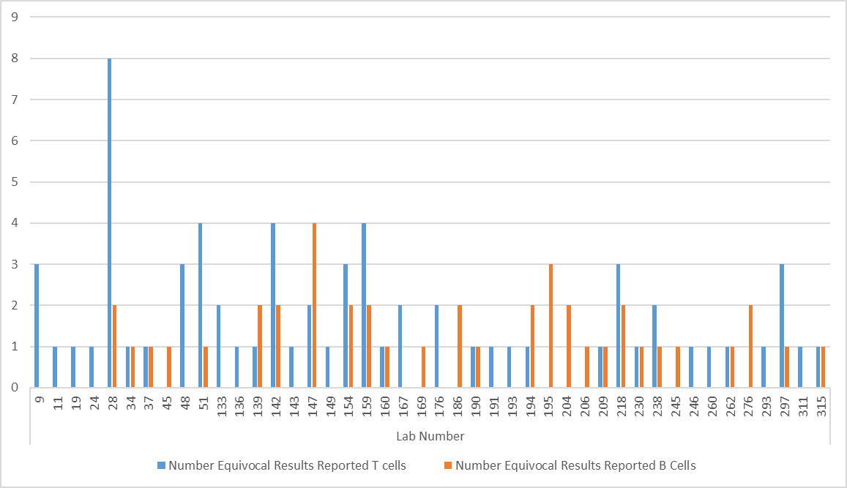
2018 Equivocal Reports Per Lab
44/83 labs reported an equivocal result (10/22 UK&I)
28/83 labs reported >1 equivocal result
Notes:
47

Slide 48
Equivocal Reports Per Lab 2017
13/22 labs reported ≥1 equivocal result
Notes:
48

Slide 49
Scheme 2B
Discussion

Slide 50
Scheme 6
HLA Antibody Detection

Slide 51
Scheme 6
Purpose: To assess participants’ ability to correctly determine the presence of HLA antibodies
12 serum samples sent in two distributions
Consensus: determined by at least 75% agreement on a presence or absence of an antibody
Satisfactory Performance: Making 80% of reports in agreement with the consensus result in a distribution year.

Slide 52
Scheme 6 Performance
5 Unsatisfactory Performers (0 UK & Ireland)
 | 2015 | 2016 | 2017 | 2018
Number of Participants (UK&I) | 97 (24) | 98 (24) | 101 (24) | 88 (25)
Number with Unsatisfactory Performance (< 80%) (UK&I) | 6 (3) | 18 (4) | 21 (0) | 5 (0)
% Unsatisfactory Performance | 6.2% (12.5%) | 18.4% (16.7%) | 20.8% (0%) | 5.7% (0%)
  The 5 labs with unacceptable performance:
  1 used Immucor kits only (1 mixed)
  4 gave no information as to kit usage

Slide 53
Not Assessed Samples
2018 Sample | Class I All Labs (n=90) | Class I UK&I (n=25) |  | Class II All Labs (n=88) | Class II UK&I (n=24)
601 | 92.9% | 96% |  | 97.5% | 100%
602 | 90.5% | 100% |  | 98.8% | 100%
603 | 90.4% | 96% |  | 91.3% | 96%
604* | 56.6% | 52% |  | 100% | 100%
605 | 100% | 100% |  | 100% | 100%
606 | 95.2% | 100% |  | 61.3% | 60%
607 | 98.8% | 100% |  | 100% | 100%
608 | 75.3% | 100% |  | 100% | 100%
609 | 100% | 100% |  | 100% | 100%
610 | 100% | 100% |  | 100% | 100%
611* | 70.2% | 52% |  | 100% | 100%
612* | 74.1% | 56% |  | 51.2% | 62.5%
Green denotes agreement on negative result
* Denotes samples were sourced from non-transfused male donors

Slide 54
Scheme 6 Errors
58/1573 (3.7%) results out of consensus (7 UK&I)
More false negative results in RoW but UK&I tendency for more false positive results
Is non-specific binding an issue (sample 604, 611 612)?
Error | UK&I | RoW
Class I only | 5 | 43
Class II only | 2 | 2
Class I & II | 0 | 6
 | Class I |  | Class II
 | False Pos | False Neg | False Pos | False Neg
UK&I | 3 | 2 | 2 | 0
RoW | 13 | 30 | 5 | 3
Notes:
Slightly higher error rate than 2015

Slide 55
Interesting Results: 608/2018
Class I Consensus Positive (overall 75.3%, UK&I 100%)
  64 labs reported positive, 21 reported negative
18 Labs that use Immucor kits, 12 of them reported a Negative result
29 Labs use One Lambda kits all reported a Positive result
Labs used numerous different kits to detect the presence/absence of antibodies
Should we standardise?
  Scheme 6 operates purely as a detection scheme. We do not state what detection methods have to be used to achieve this but it is important that the techniques used reflect clinical practice.

Slide 56
Kit Differences Affecting Consensus
Five 2018 non-consensus results were re-analysed by kit manufacturer.
For labs reporting using One Lambda kits only (n=28)
  1/5 results reached consensus (sample 612 CII).
For Immucor only users (n=15)
  3/5 results reached consensus (sample 611 CI, 612 CI and CII).
In 3/5 results the consensus/majority result differed between the manufacturers
  604, 606, 612
2018 Samples | All Labs (n=CI 90, CII 88) | One Lambda (n=28) | Lifecodes (n=15)
604 Class I | 56.6% | 51.9% | 60.0%
606 Class II | 61.3% | 64.3% | 64.3%
611 Class I | 70.2% | 53.6% | 78.6%
612 Class I | 74.1% | 64.3% | 78.6%
612 Class II | 51.2% | 75.0% | 84.6%
Green denotes agreement on negative result, red denotes agreement on positive result

Slide 57
Mixed v Single Antigen
Mixed kits have an ‘undetermined’ region
Scheme requires ‘positive’ or ‘negative’ result
  Test using additional kits
Known sensitivity difference between mixed and SA beads
  Many labs reported testing using single antigen beads
  Could account for not-assessed results
Samples containing marginal antibodies

Slide 58
Scheme 3
HLA Antibody Specificity Analysis

Slide 59
Scheme 3
Purpose: To assess participants’ ability to correctly determine the specificity of HLA antibodies
10 serum samples sent in two distributions
Consensus: Presence of a specificity is determined by at least 75% of labs agreeing, absence is determined by at least 95% of labs agreeing
Satisfactory Performance: Making at least 75% of specificities in agreement with the consensus result in a distribution year.

Slide 60
Scheme 3 Performance
CI 20 Unsatisfactory Performers (1 UK&I), CII 15 UP (0 UK&I)
Class I |  | 2015 | 2016 | 2017 | 2018
Number of Participants (UK&I) |  | 81 (24) | 85 (24) | 72 (24) | 73 (25)
Number with Unsatisfactory Performance (UK&I) | Presence | 9 (1) | 8 (0) | 10 (0) | 15 (1)
 | Absence | 2 (0) | 3 (0) | 3 (0) | 5 (0)
% Unsatisfactory Performance | Presence | 11.1% | 9.4% | 13.8% | 20.5%
 | Absence | 2.5% | 3.5% | 4.2% | 6.8%
Class II |  | 2015 | 2016 | 2017 | 2018
Number of Participants (UK&I) |  | 81 (24) | 85 (24) | 72 (24) | 75 (25)
Number with Unsatisfactory Performance (UK&I) | Presence | 4 (0) | 5 (0) | 5 (0) | 12 (0)
 | Absence | 3 (0) | 4 (0) | 2 (0) | 3 (0)
% Unsatisfactory Performance Presence/ Absence | Presence | 4.9% | 5.9% | 6.9% | 16.0%
 | Absence | 3.7% | 4.7% | 2.8% | 4.0 %

Slide 61
Unacceptable Performers 2018
 | Class I |  | Class II |  | Kit
Lab | Presence | Absence | Presence | Absence
100 | 64.9% | 98.8% | 84.0% | 95% | Lifecodes
133 | 73.3% | 100% | 96.0% | 100% | Lifecodes
197 | 59.1% | 94.6% | 54.3% | 84.9% | No Info
212 | 53.3% | 72.5% | 47.9% | 89.1% | Lifecodes
214 | 47.1% | 95.7% | 76.6% | 95.8% | Lifecodes
216 | 27.1% | 98.4% | 60.6% | 99.2% | Lifecodes
218 | 69.3% | 99.6% | 76.6% | 100% | Lifecodes
222 | 80.9% | 59.7% | 83.0% | 73.9% | No Info
229 | 0% | 0% | 0% | 0% | No Info
230 | 46.2% | 83.7% | 64.9% | 100% | Lifecodes
242 | 56.4% | 100% | 51.1% | 99.2% | One Lambda
252 | 22.2% | 94.6% | 40.4% | 99.2% | Lifecodes
268 | 90.2% | 100% | 73.4% | 100% | One Lambda
293 | 71.6% | 95.7% | 79.8% | 94.1% | One Lambda
302 | 70.2% | 76.0% | 64.9% | 75.6% | Lifecodes
392 | 0% | 0% | 0% | 0% | No Info
401 | 0% | 0% | 0% | 0% | No Info
17 labs
(1 UK&I) with
UP (<75%)

Slide 62
Class I Assessment
 | Number of HLA Class I Specificities (n=89)
 | 301 | 302 | 303 | 304 | 305 | 306 | 307 | 308 | 309 | 310 | Total
Present (≥75%) | 33 | 13 | 7 | 23 | 12 | 5 | 23 | 37 | 27 | 45 | 225
Absent (<5%) | 30 | 44 | 20 | 29 | 41 | 24 | 25 | 16 | 28 | 1 | 258
Absent 0% | 11 | 27 | 52 | 17 | 19 | 44 | 18 | 8 | 13 | 4 | 213
Not Assessed (5-74%) | 15 | 5 | 10 | 20 | 17 | 16 | 23 | 28 | 21 | 39 | 194
677 specificities reported over 10 samples
33.2% reached consensus presence
38.1% reached consensus absence
28.7% specificities were not assessed

Slide 63
Class II Assessment
DPB included in assessment in 2018
 | Number of HLA Class II Specificities (DR, DQ, DP) (n=46)
 | 301 | 302 | 303 | 304 | 305 | 306 | 307 | 308 | 309 | 310 | Total
Present (≥75%) | 13 | 14 | 4 | 7 | 5 | 1 | 11 | 20 | 0 | 19 | 94
Absent (<5%) | 16 | 11 | 11 | 17 | 19 | 7 | 11 | 7 | 19 | 1 | 119
Absent 0% | 10 | 8 | 27 | 18 | 19 | 29 | 15 | 12 | 24 | 0 | 162
Not Assessed (5-74%) | 7 | 13 | 1 | 4 | 3 | 9 | 9 | 7 | 3 | 26 | 82
295 specificities reported over 10 samples
31.9% reached consensus presence
40.3% reached consensus absence
27.8% specificities were not assessed

Slide 64
DPB only
 | Number of HLA DPB Specificities (n=19)
 | 301 | 302 | 303 | 304 | 305 | 306 | 307 | 308 | 309 | 310 | Total
Present (≥75%) | 0 | 10 | 0 | 0 | 0 | 0 | 0 | 4 | 0 | 0 | 14
Absent (<5%) | 10 | 1 | 1 | 4 | 7 | 1 | 5 | 4 | 6 | 1 | 40
Absent 0% | 9 | 6 | 17 | 11 | 12 | 17 | 12 | 10 | 11 | 0 | 105
Not Assessed (5-74%) | 0 | 2 | 1 | 4 | 0 | 1 | 2 | 1 | 2 | 18 | 31
2 samples had DPB1 specificities that reached consensus
85 specificities reported over 10 samples
16.5% reached consensus presence
47.1% reached consensus absence
36.4% specificities were not assessed

Slide 65
DPA and DQA
Labs reported DQA (=53) and DPA (n=44)
Continue to report DQA and DPA, but these will not be assessed in 2019
 | Number of HLA DQA Specificities
 | 301 | 302 | 303 | 304 | 305 | 306 | 307 | 308 | 309 | 310 | Total
Present (≥75%) | 0 | 0 | 0 | 0 | 0 | 0 | 0 | 0 | 0 | 0 | 0
Absent (<5%) | 2 | 6 | 4 | 5 | 3 | 2 | 2 | 0 | 1 | 0 | 25
Not Assessed (5-74%) | 5 | 3 | 4 | 2 | 2 | 1 | 6 | 10 | 0 | 12 | 45
 | Number of HLA DPA Specificities
 | 301 | 302 | 303 | 304 | 305 | 306 | 307 | 308 | 309 | 310 | Total
Present (≥75%) | 0 | 0 | 0 | 0 | 0 | 0 | 0 | 0 | 0 | 0 | 0
Absent (<5%) | 0 | 1 | 0 | 3 | 0 | 0 | 0 | 1 | 3 | 0 | 8
Not Assessed (5-74%) | 1 | 4 | 0 | 0 | 0 | 0 | 0 | 6 | 0 | 7 | 18

Slide 66
Schemes 3, 6
Discussion

Slide 67
Scheme 9
KIR Genotyping

Slide 68
Scheme 9
Purpose: To assess participants’ ability to correctly determine the presence or absence of specific KIR genes
10 blood samples sent in two distributions
Consensus: Genotype is determined by at least 75% of laboratories agreeing the presence/absence of each gene. Where consensus can’t be reached a reference type will be used
Satisfactory Performance: Obtaining 9 or more full KIR genotypes in agreement with the consensus result in a distribution year.

Slide 69
KIR Genotyping
Participants able to report any of the following: KIR2DL1, KIR2DL2, KIR2DL3, KIR2DL4, KIR2DL5, KIR3DL1, KIR3DL2, KIR3DL3, KIR3DS1, KIR2DS1, KIR2DS2, KIR2DS3, KIR2DS4, KIR2DS5, KIR2DP1, KIR3DP1.
Also able to report any other KIR polymorphisms they detected for information
Participants can also report an ‘A’ or ‘B’ haplotype for each sample based on the gene content of the sample

Slide 70
Performance 2018
3 Errors
1 Unsatisfactory Performer
 | 2015 Pilot | 2016 Pilot | 2017 | 2018
Number of Participants (UK&I) | 7 (1) | 11 (2) | 8 (3) | 9 (1)
Number with Unsatisfactory Performance (UK&I) | N/A | N/A | 0 (0) | 1 (0)
% Unsatisfactory Performance (UK&I) | N/A | N/A | 0% | 11.1%

Slide 71
Scheme 10
HPA Genotyping

Slide 72
Scheme 10
Purpose: To assess participants’ ability to correctly determine HPA polymorphisms
10 blood samples sent in two distributions
Consensus: determined by at least 75% of labs agreeing the presence/absence of each allele, a reference result is used for results failing to reach consensus
Satisfactory Performance: Obtaining 9 or more full HPA types in agreement with the consensus/reference result in a distribution year.

Slide 73
HPA Genotyping
Participants able to report any of the following: HPA‐1, HPA‐2, HPA‐3, HPA‐4, HPA‐5, HPA‐6, HPA‐15
  25/37 reported HPA-1, 2 , 3, 4, 5 and 15
  30/37 labs reported HPA-4
  24/37 labs reported HPA-6
Also able to report any other HPA polymorphisms detected, for information

Slide 74
Performance 2018
3 Errors (RoW only)
1 Unsatisfactory Performer
 | 2015 Pilot | 2016 Pilot | 2017 | 2018
Number of Participants (UK&I) | 14 (3) | 12 (4) | 15 (5) | 37 (6)
Number with Unsatisfactory Performance (< 100%) (UK&I) | N/A | N/A | 1 (0) | 1 (0)
% Unsatisfactory Performance (UK&I) | N/A | N/A | 6.7% | 2.7%

Slide 75
Scheme 11
HPA Antibody Detection/Specification

Slide 76
Scheme 11
NIBSC no longer offering platelet genotyping or antibody schemes, participants offered to transfer to NEQAS
Purpose: To assess participants’ ability to correctly determine the presence and specificity of HPA antibodies
8 serum/plasma samples sent in two distributions
Consensus: Presence of a specificity is determined by at least 75% of labs agreeing, absence is determined by at least 95% of labs agreeing
Satisfactory Performance: Making at least 75% of specificities in agreement with the consensus result in a distribution year.

Slide 77
Performance 2018
1 Unsatisfactory Performer (0 UK & Ireland)
 | 2017 Pilot | 2018
Number of Participants (UK&I) | 13 (3) | 35 (4)
Number with Unsatisfactory Performance (< 75%) (UK&I) | N/A | 1 (0)
% Unsatisfactory Performance (UK&I) | N/A | 2.9%

Slide 78
HPA Antibody Detection/Specification
Only 1 sample could not be assessed for HPA detection
3 samples were not assessed for HPA antibody presence
2018 Sample | HPA Detection | HLA Detection | HPA Antibody ID
 |  |  | Presence | Absence
1 | 100% Neg | 100% Neg | 100% Neg
2 | 100% Pos | 100% Pos | HPA-5b 96.9% | 3.1% HPA-3b, 5a, 15a
3 | Not Assessed (64.5% Pos) | 100% Neg | Not Assessed | 3.2% GPIIa/IIIb
4 | 90% Neg | 100% Pos | 96.7% Neg
5 | 76.5% Neg | 92.9% Neg | Not Assessed | 77.1% HPA Neg
6 | 100% Neg | 100% Pos | 100% Neg
7 | 100% Pos | 100% Pos | HPA-5b 97.1% | HPA-15b 2.9%
8 | 94.1% Neg | 89.3% Neg | Not Assessed | 91.4% HPA Neg
Result for Sample 3 | Method of HPA Detection | Number of Labs
Negative | MAIPA | 11
Positive | Luminex | 7
 | MAIPA | 5
 | Luminex/MAIPA | 8

Slide 79
Schemes 9, 10, 11
Discussion

Slide 80
Prof David Briggs
Quantitative Measurement of HLA Specific Antibodies

Slide 81
Lunch
Please be back for a 13:30 start

Slide 82
Dr Martin Rutter
Islet Cell Transplantation: A Clinical Perspective

Slide 83
Scheme 1A
HLA Phenotyping

Slide 84
Scheme 1A
Purpose: To assess participants’ ability to correctly use serological and supplementary methods to correctly identify HLA specificities
10 blood samples sent in two distributions
Consensus: Presence of a specificity is determined by at least 75% of labs in agreement
Satisfactory Performance: Making 9 or more complete HLA phenotypes in agreement with the consensus result in a distribution year.

Slide 85
1A Performance 2018
6 labs with Unsatisfactory Performance (1 UK&I)
 | 2012 | 2013 | 2014 | 2015 | 2016 | 2017 | 2018
Number of Participants (UK&I) | 22 (10) | 30 (10) | 42 (9) | 45 (9) | 41 (7) | 38 (6) | 38 (6)
Number with Unsatisfactory Performance (< 90%) (UK&I) | 1 (0) | 0 (0) | 8 (0) | 4 (0) | 3 (0) | 1 (0) | 6 (1)
% Unsatisfactory Performance | 4.5% | 0.0% | 19.0% | 8.9% | 7.3% | 2.6% | 15.8%

Slide 86
2018 Incorrect Assignments
Sample | Lab Number | Consensus | Report
1A 02 | 62 | DQ2, DQ8 | DQ2, DQ7
1A 03 | 181 | A2, A25; B51, B55; Cw9, Cw14; DR4, DR13; DQ6, DQ7 | DRB1*04:01, 13:01; DQB1*06:03, 03:01
 | 286 |  | A*02:01:01:01, A*25:01:01:01; B*51:01:01:01, B*55:01:01; C*03:03:01:01, C*14:02:01:01; DRB1*04:01:01:02, DRB1*13:01:01:01; DQB1*06:03:01:01, DQB1*03:01:01:01
1A 04 | 62, 163 | A2, A68; B18, B57; Cw5, Cw6; DR1, DR103; DQ5, - | DR1, -
 | 181 |  | DRB1*01:01, DRB1*01:03; DQB1*05:01, -
 | 194 |  | A2, A69
 | 225 |  | B18, B58
 | 286 |  | A*02:01:01:01, A*68:02:01:01; B*18:01:01:02, B*57:01:01:01; C*05:01:01:02, C*06:02:01:01; DRB1*01:01:01, DRB1*01:03:01; DQB1*05:01:01:02, -
 | 315, 401 |  | DR1, -

Slide 87
2018 Incorrect Assignments
Sample | Lab Number | Consensus | Report
1A 05 | 159, 401 | B7, B61 | B7, B40
1A 09 | 223 | A2,A25; DR4, DR7; DQ2, DQ8 | A*02, A25
 | 315 |  | A*02, A25; DRB1*04, DRB1*07; DQB1*02, DQB1*03:02
1A 10 | 223 | A2, A3; B7, B38; DQ6, - | A*02, A*03; B*07, B38
 | 315 |  | A*02, A*03; B*07, B38; DQB1*06, -
17/380 (4.5%) incorrect HLA types in 2018 reported by 10 labs;
  5 reports of incorrect broad/split specificity
  8 reports of molecular based nomenclature
  4 reports of missed specificity (i.e. reported blank)

Slide 88
Scheme 4A1
DNA Typing at 1st Field Resolution

Slide 89
Scheme 4A1
Purpose: To assess participants’ ability to correctly determine HLA types at the 1st field
10 blood samples sent in two distributions
Consensus: Presence of an allele is determined by at least 75% of labs agreeing, a reference result is used for those failing to reach consensus and for DPB1 assessment
Satisfactory Performance: Making at least 9 full HLA types in agreement with the consensus/reference result in a distribution year.

Slide 90
Changes Introduced in 2018
Participants can register for DPB1 assessment at low/medium resolution (i.e. SSP/SSO results)
Assessed against a reference type
Report DPB1 alleles at the resolution applicable to clinical need
Strings of alleles not penalised if reference allele is present

Slide 91
4A1 Performance 2018
 | 2013 | 2014 | 2015 | 2016 | 2017 | 2018
Number of Participants (UK&I) | 96 (30) | 96 (30) | 100 (29) | 102 (28) | 106 (28) | 105 (28)
Number with Unsatisfactory Performance (< 90%) (UK&I) | 5 (0) | 9 (0) | 7 (1) | 21 (4) | 11 (1) | 15 (1)
% Unsatisfactory Performance | 5.2% | 9.4% | 7.0% | 20.6% | 10.4% | 14.3%

Slide 92
Incorrect Assignments
28/1014 (2.8%) incorrect HLA types reported by 22 labs (6 UK&I)
  13 incorrect assignments (e.g. A*26 instead of A*02)
  1 complete type error – sample mix-up (2 samples by 1 UK&I lab)
  9 missed assignments (e.g. reported homozygous/blank when hetero) – (5 UK&I)
  5 extra assignments (e.g. reported heterozygous when homozygous)
  28 other errors e.g. missed loci, DRB3/4/5 presence/absence errors
Methods for labs with errors
1 lab used SSP only
9 used Luminex only
6 used a combination (e.g.SSP&Luminex)
15 no info
Notes:
33 errors in 2015
20 extra errors (+9 missed assignments, +9 not resolving 1st field)

Slide 93
Scheme 4A1i
Interpretive HLA Genotype

Slide 94
Scheme 4A1i
Purpose: To assess participants’ ability to correctly interpret their 4A1 result to the ‘split’ specificity level
10 blood samples sourced from 4A1
Consensus: HLA type is determined by 75% of labs agreeing each specificity, a reference result is used for results failing to reach consensus
Satisfactory Performance: Making at least 9 full HLA types in agreement with the consensus/reference result in a distribution year.

Slide 95
4A1i Performance 2018
 | 2017 | 2018
Number of Participants (UK&I) | 36 (20) | 40 (21)
Number with Unsatisfactory Performance (< 90%) (UK&I) | 6 (1) | 6 (0)
% Unsatisfactory Performance | 16.7% | 15.0%

Slide 96
Interpreted DNA Results
12/380 (3.2%) incorrect HLA types reported by 8 labs (2 UK&I)
2 reports with multiple errors in HLA type
2 reports with wrong specificity (e.g. Cw5 not Cw4) (1 UK&1)
2 reports of broad, not split specificity (e.g. Cw3 not Cw10) (1 UK&I)
4 missed assignments (e.g. reported homozygous/blank instead of hetero)
2 Bw4/6 mis-assignments (e.g. Bw4 and Bw6 instead of Bw6)

Slide 97
Scheme 4A2
DNA Typing to 2nd or 3rd Field Resolution

Slide 98
Scheme 4A2
Purpose: To assess participants’ ability to correctly determine HLA type to the 2nd or 3rd field
10 blood samples sent in two distributions
Consensus: Genotype is determined by 75% of labs agreeing each allele. If consensus is not reached a reference result will be used
Satisfactory Performance: Making 9 or more full HLA types in agreement with consensus/reference genotype in a distribution year

Slide 99
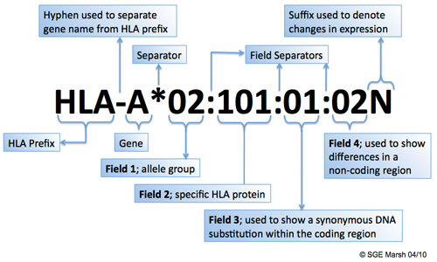
Introduced in 2018
Participants can register for assessment of 3rd field results in Scheme 4A2

Slide 100
4A2 Performance 2018
9 Unsatisfactory Performers (2 UK & Ireland)
48/63 participants registered for 2nd field
24/63 participants registered for 3rd field
 | 2014 | 2015 | 2016 | 2017 | 2018
Number of Participants (UK&I) | 59 (21) | 59 (20) | 63 (21) | 66 (21) | 63 (20)
Number with Unsatisfactory Performance (< 90%) (UK&I) | 5 (1) | 7(1) | 8 (2) | 4 (0) | 9 (2)
% Unsatisfactory Performance | 8.5% | 11.9% | 12.7% | 6.1% | 14.3%

Slide 101
4A2 Performance 2018

Slide 102
2018 Incorrect Assignments: 2nd Field
30/435 (6.9%) incorrect HLA types reported by 15 labs (6 UK&I)
15 reports of alleles in a string that differ from the consensus allele (e.g. A*01:01/09) (4 UK&I)
11 reports of incorrect allele (e.g. C*17:01 not C*17:03) (2 UK&I)
2 reports of incorrect antigen (e.g. B*44:03 instead of B*40:01)
1 report where a null allele was missed
1 report where a null allele was included

Slide 103
2018 Incorrect Assignments: 3rd Field
4/210 (1.9%) incorrect samples reported by 3 labs (1 UK&I)
1 report of 2nd rather than 3rd field resolution
2 reports of incorrect allele (e.g. DRB4*01:01:01 rather than 01:03:02)
1 report with an error at 3rd field (e.g. DRB1*03:03:01 instead of 03:03:02) (1 UK&I)

Slide 104
Ambiguous 3rd Field Results
The assessment of 3rd field results has been challenging.
  Allowed all ambiguities at the 3rd field in 2018
  Reporting should reflect clinical practice
  All ambiguities at the 3rd field must be resolved in 2019

Slide 105
Clinical Reporting
Resolution being reported should reflect clinical practice
NEQAS asked participants what level of resolution labs report at clinically 17 (27%) responses (5 from UK&I, 12 from RoW):
  What clinical services do you provide and what’s the highest resolution do you report at clinically?
 | Solid Organ Transplant | HSCT | Disease Association | Specify
First Field | 6 | 0 | 1 | 3 (HLA Selected Platelets)
Second Field | 5 | 12 | 12 | 4 (Refractoriness to Platelet Transfusions and Special Requests)
Third Field | 0 | 3 | 0 | 1 (Research Projects only)
No Response | 6 | 2 | 4 | 9

Slide 106
4th Field Results
7 labs reported results at 4th field resolution
Total of 612 alleles
515 (84.2%) reported as unambiguous 4th field result (e.g. B*07:02:01:01)
97 (15.8%) contained 3rd or 4th field ambiguities (e.g. B*40:01:02:01/04)
1 error at 4th field: DRB4*01:01:01:01 instead of 01:03:02

Slide 107
New for 2019
More stringent assessment of 3rd field resolution
  Participants must sequence all exons to resolve all ambiguities
    E.g. DRB1*07:01:01/07:79 or DQB1*03:02:01/03:02:26 would be unacceptable as ambiguities in exon 4 have not been resolved
Results at the 4th field can be reported, but will not be assessed

Slide 108
Schemes 1A, 4A1, 4A1i, 4A2
Discussion

Slide 109
Scheme 1B
HLA-B27 Testing
Notes:
109

Slide 110
HLA-B27 Testing
Purpose: To assess ability to correctly determine HLA-B27/2808/B*27 status
10 donor samples sent in five distributions
Consensus: B27 status determined by at least 75% agreement on presence or absence of HLA-B27
Satisfactory performance: Making 10 reports in agreement with consensus in a distribution year
Notes:
110

Slide 111
Performance 2018
10 Unsatisfactory Performers (3 UK & Ireland)
 | 2013 | 2014 | 2015 | 2016 | 2017 | 2018
Number of Participants (UK&I) | 96 (47) | 107 (51) | 115 (54) | 123 (54) | 127 (52) | 133 (54)
Number with Unsatisfactory Performance (< 100%) (UK&I) | 4 (1) | 4 (2) | 8 (4) | 15 (6) | 7 (2) | 10 (3)
% Unsatisfactory Performance (UK&I) | 4.2% (2.1%) | 3.7% (3.9%) | 6.9% (7.4%) | 12.2% (11.1%) | 5.5% (3.8%) | 7.5% (5.6%)

Slide 112
2018 Incorrect Assignments
Sample | Result | Lab Number | Technique | HLA Type | Lab Identified Cause
1B01 | False Neg | 106*, 256, 279 | Serological | B27, B47 | No reply Low lymphocyte reactivity
1B02 | False Neg | 67, 83, 106*, 256, 279 | Serological | B27, B60 | Kit Ambiguity No response Transcription Error Low lymphocyte reactivity
1B05 | False Neg | 10*, 372 | Serological | B27, B65 | Delay in testing causing poor viability No response
1B06 | False Pos | 106* | *Unknown | B38, B50 | No response
1B09 | False Pos | 10*, 372 | Serological | B27, B65 | Delay in testing causing poor viability No response
1B10 | False Pos | 106* | *Unknown | B38 B50 | No response
6/10 samples distributed were HLA-B27 positive
14 errors: 10 False Neg, 4 False Pos

Slide 113
Scheme 5A
HFE Typing
Notes:
113

Slide 114
Scheme 5A
Purpose: To assess participants ability to correctly determine HFE mutations
  3 mutations assessed:
    Codon 63: Histidine63Aspartic acid (H63D)
    Codon 282: cysteine282tyrosine (C282Y)
    Codon 65: Serine63Cysteine (S65C)
10 donor samples sent in two distributions
Consensus: determined by at least 75% agreement with the consensus/reference result
Satisfactory Performance: 10 reports in agreement with consensus in a distribution year
Notes:
114

Slide 115
Scheme 5A Performance
No Unsatisfactory Performers
 | 2013 | 2014 | 2015 | 2016 | 2017 | 2018
Number of Participants (UK&I) | 58 (10) | 59 (50) | 60 (49) | 58 (49) | 56 (42) | 58 (44)
Number with Unsatisfactory Performance (< 100%) (UK&I) | 2 (2) | 2 (2) | 0 (0) | 3 (2) | 3 (2) | 0 (0)
% Unsatisfactory Performance | 3.9% | 3.4% | 0% | 5.2% | 5.3% | 0%

Slide 116
Scheme 5B
Interpretative HFE genotype
and hereditary haemochromatosis

Slide 117
Scheme 5B
Purpose: to assess participants’ ability to make an accurate, clear and concise clinical report
Twice a year, 2 clinical scenarios:
  HFE genotype provided, together with various pieces of clinical information
Reports must be identical in format to that used for routine clinical reporting in participants’ laboratories
Interpretative criteria expected to be covered by the reports are identified and agreed by the expert assessors.
  Penalty points awarded, if >50% of the available penalty points are awarded then performance is unacceptable

Slide 118
Performance
2018 – all 4 scenarios
5 penalty points per scenario, 20 in total
3 labs got 1 penalty point
4 labs got 2 penalty points
7 labs got 3 penalty points
2 labs got 5 penalty points
2 labs got 6 penalty points
1 lab got 7 penalty points
1 lab got 8 penalty points
1 lab got Multiple penalty points (sent wrong report)

Slide 119
Scheme 5B Performance
1 Unsatisfactory Performer (1 UK&I)
 | 2012 | 2013 | 2014 | 2015 | 2016 | 2017 | 2018
Number of Participants | 21 | 19 | 20 | 18 | 19 | 20 | 21 (18)
Number with Unsatisfactory Performance | 3 | 3 | 5 | 0 | 0 | 0 | 1 (1)
% Unsatisfactory Performance | 14.3% | 15.8% | 25.0% | 0% | 0% | 0% | 4.8%

Slide 120
Scheme 7
HLA-B*57:01 Typing for Drug Hypersensitivity
Notes:
120

Slide 121
Scheme 7
Purpose: To assess participants’ ability to correctly determine HLA-B*57:01 status.
10 random donor samples sent in two distributions
Consensus: determined by at least 75% agreement with the consensus/reference result
Satisfactory Performance: Making ten sample reports in agreement with the consensus HLA-B*57:01 status in a distribution year.

Slide 122
Scheme 7 Performance
7/10 samples distributed were HLA-B*57:01 positive
2 labs with unacceptable performance
  Both did not return results
 | 2013 | 2014 | 2015 | 2016 | 2017 | 2018
Number of Participants (UK&I) | 47 (23) | 56 (24) | 62 (26) | 62 (25) | 64 (26) | 67 (27)
Number with Unacceptable Performance (< 100%) (UK&I) | 0 (0) | 1 (0) | 0 (0) | 1 (1) | 4 (1) | 2 (0)
% Unsatisfactory Performance | 0.0% | 1.8% | 0.0% | 1.6% | 6.3% | 3.0%

Slide 123
Scheme 8
HLA Genotyping for Coeliac
and other HLA Associated Disease
Notes:
123

Slide 124
Scheme 8
Purpose: To assess participants’ ability to correctly determine HLA type associated with various diseases e.g. coeliac disease and narcolepsy
10 donor samples sent in two distributions
Consensus: determined by assessment against the reference result
Satisfactory Performance: Making ten sample reports in agreement with the reference genotype in a distribution year.

Slide 125
Scheme 8 Performance
14 Unsatisfactory Performers (4 UK & Ireland)
 | 2013 | 2014 | 2015 | 2016 | 2017 | 2018
Number of Participants (UK&I) | 19 (8) | 21 (9) | 30 (8) | 39 (8) | 45 (9) | 52 (10)
Number with Unsatisfactory Performance (< 100%) (UK&I) | 2 (1) | 3 (2) | 8 (0) | 8 (3) | 15 (2) | 14 (4)
% Unsatisfactory Performance | 10.5% (12.5%) | 14.3% (22.2%) | 26.7% (0%) | 20.5% (37.5%) | 33.3% (22.2%) | 26.9% (40%)

Slide 126
2018 Unacceptable Performance by Disease
Disease | HLA Association | Number of Participants | No. of Participants with Unacceptable Performance
Coeliac | DQ2, DQ8, DQA | 50 | 11
Narcolepsy | DQB1*06:02 | 21 | 2
Actinic Prurigo | DRB1*04:07 | 4 | 0
Birdshot Retinopathy | A*29 | 9 | 0
Behçet's | B*51 | 6 | 0
Rheumatoid Arthritis | DRB1*04 | 2 | 0
Diabetes | DR3, DR4 | 4 | 1

Slide 127
2018 Incorrect Assignments
Sample | Lab | Result | HLA Type | Error
801 | 85 | Negative for DQ2 and DQ8 | DRB1*04:01, DRB1*07:01/34/72; DQB1*02:02, DQB1*03:01; DQA1*02:01, DQA1*03:03 | Interpretation issue
 | 185 | DRB1*04, DRB1*07, DQA1*02:01, DQA1*03:02, DQB1*02:02, DQB1*03:01 |  | Transcription error
 |  |  |  | Interpretation issue
 | 255 | HLA-DQ2: NEG HLA-DQ8: NEG
 | 278 | Beta-subunit HLA DQ8, HLA DQ8 genotype |  | No response
 | 279 | DRB1 *04; *07, DQB1 *02:02; *03:01 DQA1 *02:01; *03:01 |  | Technical issue
 | 319 | DQ2: NEG DQ8: NEG |  | Interpretation issue
802 | 78 | DQ2 and DQ8 ABSENT | DRB1*03:01/124/132/137, DRB1*04:08; DQB1*02:01, DQB1*03:01; DQA1*03:03, DQA1*05:01 | Technical issue
 | 185 | DRB1*03, DRB1*04, DQA1*03:02, DQA1*05:01, DQB1*02:01, DQB1*03:01 |  | Transcription error
 | 279 | DRB1 *03; *04 DQB1 *02:01; *03:01 DQA1 *03:01; *05:01 |  | Technical issue
803 | 159 | DQA1*01:01-05, *05:05 DQB1*03:01, *05:01 | DRB1*11:01/97, DRB1*15:01/141; DQB1*03:01, DQB1*06:02; DQA1*01:02/11, DQA1*05:05 | Kit issue
804 | 159 | DQA1*01:01-05, *05:05 DQB1*03:01, *05:01 | DRB1*01:03, DRB1*13:01/117/190/215; DQB1*03:01, DQB1*06:03; DQA1*01:03, DQA1*05:05 | Kit issue

Slide 128
2018 Incorrect Assignments
Sample | Lab Number | Result | HLA Type | Error
806 | 86 | Coeliac disease-associated HLA alleles present: DQB1*03:01 DQA1*05:05 HLA DQ2: PRESENT - HLA-DQA1*05, HLA DQ8: ABSENT | DRB1*13:01, DRB1*13:03; DQB1*03:01, DQB1*06:03; DQA1*01:03, DQA1*05:05 | Kit issue
808 | 123 | DQB1*07, DQB1*03:03 | DRB1*07:01, DRB1*09:01; DQB1*02:02, DQB1*03:03; DQA1*02:01, DQA1*03:02 | No response
 | 319 | DQ2: NEG DQ8: NEG (A1*05: NEG, B1*02: POS, B1*0302: NEG) |  | No response
809 | 129 | DRB1*0401, - | DRB1*04:01, DRB1*07:01; DQB1*02:02, DQB1*03:02; DQA1*02:01, DQA1*03:01 | Interpretation issue
 | 319 | DQ2:NEG, DQ8:POS (A1*05: NEG, B1*02: POS, B1*0302: POS) |  | No response
810 | 17 | HLA-DQA1*05:01; DQB1*02:01 Positive HLA-DQA1*03; DQB1*03:02 Negative | DRB1*04:01, DRB1*15:01; DQB1*03:01, DQB1*06:02; DQA1*01:02, DQA1*03:03 | Technical issue
 | 279 | DRB1*04; DQB1*03:01,*05:01; DQA1*03:01 |  | Kit issue
18 incorrect assignments in 2018 (4 UK&I), 17/18 in Coeliac Disease
  Also 2 labs did not report any results for samples 801-805/2018

Slide 129
Participant Issues
CAPA responses show some common problems:
  sample handling or technical error - 2 labs (18%)
  Incorrect interpretation of a correct HLA type - 3 labs (27%)
  ambiguous kit results or resolution issue - 4 labs (37%)
  2 labs (18%) did not respond
Labs struggled the incorrect interpretation of a correct HLA type
  a lab reported that DQ2 was present or “Half DQ2 positive” when they had detected HLA-DQB1*03:01, DQA1*05:05 as they wanted to report they had detected the DQA1*05 subunit.

Slide 130
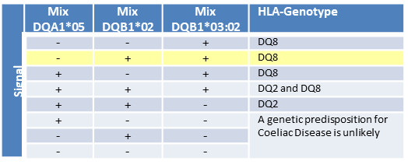
Participant Issues
Commercial kits also been to be the cause of some issues due to deficiencies in resolution and the interpretation of results:
Currently interpretative comments are collected but not assessed
Examples from UK labs to the same sample:
  This patient is DQ2.2 positive, heterozygous. This patient is DQ2 positive which is associated with Coeliac Disease.
  This individual does not carry the HLA-DQ variants associated with Coeliac Disease.
  This patient is Heterozygous POSITIVE for HLA-DQ2 (but is DQA1*05 NEGATIVE) and NEGATIVE for HLA-DQ8 (DQA1*03, DQB1*03:02). Patients with this genotype have a LOW RISK of predisposition to Coeliac disease.
  This table taken from a commercial kit insert shows how misleading it can be especially for labs with limited H&I experience

Slide 131
Coeliac Guidelines
Arthi Anand
Helena Lee

Slide 132
Scheme 8
Aimed at laboratories that provide a service as an aid to the diagnosis of Class I and Class II HLA associated diseases, e.g. coeliac disease, birdshot retinopathy, actinic prurigo and narcolepsy
HLA genotyping findings are reported relevant to each disease registered for
Interpretative comments for the disease risk the genotype confers, as reported clinically may also be reported (not assessed).

Slide 133
Assessment Procedure
Assessment Procedure: Each HLA genotype in agreement with the 1 st or 2nd field reference type
Unacceptable - Each HLA genotype not in agreement with 1st or 2nd field reference type
Interpretative comments can be included although these will not be assessed

Slide 134
Questionnaire Results
Variety of reporting methods used (overseas labs) hence questionnaire sent
50 UK and overseas labs responded
12 use SSP kits
10 use Luminex based methods
2 use RT-PCR
2 use microarray
24 not reported

Slide 135
Reporting HLA Types
DQ2.5: Negative (DQA1*05: Negative, DQB1*02: Negative)
DQ2.2: Negative (DQA1*02: Negative, DQB1*02: Negative)
DQ8: Negative (DQA1*03: Negative, DQB1*03:02: Negative)
Positive for DQB1*02 but negative for DQA1*05.
no specific coeliac disease predicting haplotype detected
DQA1*03:02/03 ; DQB1*03:01; DRB1*04. Presence of HLA haplotype not associated with Coeliac Disease according to ESPGHAN guideline .
Found DQA1*05 negative, DQB1*02 negative and DQB1*03:02 negative, therefore is a genetic predisposition for Coeliac Disease unlikely

Slide 136
Nice Guidelines
Do not use human leukocyte antigen (HLA) DQ2 (DQ2.2 and DQ2.5)/DQ8 testing in the initial diagnosis of coeliac disease in non-specialist settings
HLA DQ2 (DQ2.2 and DQ2.5)/DQ8 testing in the diagnosis of coeliac disease in specialist settings (for example, in children who are not having a biopsy)

Slide 137
British Society of Gastroenterology and ESPGHAN Guidelines
Role of HLA in the diagnosis of CD: associated with the carriage of the gene pairs that encode DQ2.5 and DQ8.
High negative predictive value
However, the positive predictive value of the HLA genotyping for CD susceptibility is very low as a large proportion of individuals without CD carry either HLA-DQ2 or HLA-DQ8
A positive DQ2.5 or DQ8 can never confirm the diagnosis. (Grade B)
HLA typing should be used in individuals who are self-treated on a GFD and never had appropriate testing for CD before changing their diet. (Grade B)
HLA typing can be used to rule out CD, and minimise future testing, in high-risk individuals with CD, for example, first-degree relatives. (Grade B)

Slide 138
CLINICAL GASTROENTEROLOGY AND HEPATOLOGY 2009;7:966–971

Slide 139
Proposed Risk Stratification
DQB1 Haplotypes associated with coeliac disease | Interpretative comment
Scenario 1: HLA-DQB1*02:01 (DQ2) negative / DQB1*03:02 (DQ8) negative
The presence of both HLA-DQA1*05:01 and DQB1*02:01 (DQ2) (DQ2.5 haplotype) and DQB1*03:02 (DQ8) are found in >97% of patients with coeliac disease. | This individual does not carry the HLA-DQ variants associated with coeliac disease.
Scenario 2: HLA-DQB1*02:01 (DQ2) positive / DQB1*03:02 (DQ8) positive
The presence of both DQB1*02:01 and DQB1*03:02 have a very strong association with coeliac disease. | This individual carries both the DQA1*05:01, DQB1*02:01 (HLA-DQ2) variant and the HLA DQB1*03:02 (HLA-DQ8) variant associated with coeliac disease (Very high risk).
Scenario 3: HLA-DQB1*02:01 (DQ2) positive homozygous patient
Homozygosity for the presence of HLA-DQ2 (DQA1*05:01, DQB1*02:01, the DQ2.5 haplotype) has a very strong association with coeliac disease. | This individual is homozygous for the DQA1*05:01, DQB1*02:01 (HLA-DQ2) variant associated with coeliac disease (Very high risk).
Scenario 4: HLA-DQB1*02:01 (DQ2) positive / DQB1*03:02 (DQ8) negative
The presence of DQA1*05:01, DQB1*02:01 (DQ2), the DQ2.5 haplotype) has a strong association with coeliac disease. | This individual carries the DQA1*05:01, DQB1*02:01 (HLA-DQ2) variant associated with coeliac disease (High risk).

Slide 140
Proposed Risk Stratification
DQB1 Haplotypes associated with coeliac disease | Interpretative comment
Scenario 5: HLA-DQB1*02:01 (DQ2) negative / DQB1*03:02 (DQ8) positive
If the patient is DQB1*03:02 (DQ8) positive in the absence of the HLA-DQA1*05:01 and DQB1*02:01 (DQ2) haplotype. | This individual carries the HLA-DQB1*03:02 (DQ8) variant that has an association with coeliac disease (High risk).
Scenario 6: (DQ2) negative / DQB1*03:02 (DQ8) negative BUT HLA-DQB1*02:02 (DQ2) positive
If the patient is DRB1*07, DQA1*02:01, DQB1*02:02 (DQ 2.2 haplotype) and DRB1*11, DQA1*05:05, DQB1*03:01.This haplotype can also appear less commonly as DQ2.2 homozygous. | This individual carries the HLA-DQB1*02:02 (DQ2) variant that has a weak association with coeliac disease (Low risk).
Scenario 7: HLA-DQB1*02:01 (DQ2) negative / DQB1*03:02 (DQ8) negative BUT DQA1*05:05, DQB1*03:01 positive
The patient is DQA1*05:05, DQB1*03:01 (Variant DQ2.5 positive) | The individual carries DQA1*05:05 and DQB1*03:01 which have shown a weak association with Coeliac disease (Very low risk).
Scenario 8: HLA-DQB1*02:01 (DQ2) negative / DQB1*03:02 (DQ8) negative BUT HLA-DQB1*02:02 (DQ2) positive in the absence of DRB1*07 and DQA1*02:01
The patient is DQB1*02:02 (DQ2) positive but in the absence of DRB1*07 and DQA1*02:01 and therefore NOT the DQ2.2 haplotype as in scenario 6. | This individual does not carry the HLA-DQ variants associated with coeliac disease.

Slide 141
Points to Consider
Should we be HLA typing DRB3 – DRB3*01:01:02 or 02:02:01
Nomenclature to use on reports
Risk stratification according to DQ type and homozygous/heterozygous

Slide 142
References
Stratifying risk for Coeliac disease in a large at-risk United States population by using HLA alleles. Pietzak M., Schofield T., McGinniss M., and Nakamura R. Clinical gastroenterology and hepatology 2009;7:966–971.
Clinical utility of Coeliac disease associated HLA testing. Pallav K., Kabbani T., Tariq S., Vanga R., Kelly C., and Leffler D. Dig Dis Sci. 2014; 59: 2199–2206.
Diagnosing Coeliac disease and the potential for serological markers. Husby S., Murray J. Nature Review in Gastroenterology and Hepatology 2014; 11: 655–663.

Slide 143
Schemes 1B, 5A, 5B, 7, 8
Discussion

Slide 144
Steering Committee
Q&A Session

Slide 145
Scheme Performance – UK&I
 | 2013 | 2014 | 2015 | 2016 | 2017 | 2018
Scheme 1A | 0 | 0 | 0 | 0 | 0 | 1
Scheme 1B | 1 | 2 | 4 | 6 | 3 | 3
Scheme 2A Without DTT Scheme 2A With DTT | 2 N/A | 6 N/A | 2 0 | 3 6 | 6 | 7
Scheme 2B | 0 | 2 | 3 | 1 | 1 | 2
Scheme 3 Class I Scheme 3 Class II | 1 0 | 0 0 | 1 0 | 0 0 | 0 0 | 1 0
Scheme 4A1 | 0 | 0 | 1 | 4 | 1 | 1
Scheme 4A1i | N/A | N/A | N/A | N/A | 1 | 0
Scheme 4A2 | 2 | 1 | 1 | 2 | 1 | 2
Scheme 5A | 2 | 2 | 0 | 2 | 2 | 0
Scheme 6 | 0 | 1 | 3 | 4 | 0 | 0
Scheme 7 | 0 | 0 | 0 | 1 | 1 | 0
Scheme 8 | 1 | 2 | 0 | 3 | 2 | 4
Scheme 9 | N/A | N/A | N/A | N/A | 0 | 0
Scheme 10 | N/A | N/A | N/A | N/A | 0 | 0
Scheme 11 | N/A | N/A | N/A | N/A | N/A | 0
Total | 9 | 16 | 15 | 32 | 15 | 21

Slide 146
EDXM Scheme
Incorporating Crossmatching, HLA Typing and Antibody Detection/Specification
Tracey Rees

Slide 147
‘Whole Process’ EQA
UK NEQAS for H&I
  Scheme 1A, 4A1, 4A2 – HLA Typing
  Scheme 6 – HLA Antibody Detection
  Scheme 3 – HLA Antibody Specification
  Schemes 2A and 2B – Crossmatching
  Solid Organ Interpretive Scenarios (Paper based)
“Schemes should relate more closely to clinical scenarios rather than testing individual test assays.”
Clinical decision making based on results from multiple assays
Each assay only gives part of the picture
Results from one assay can influence the interpretation of another
Variation between centres
  Sensitivity/cut offs
  Assay repertoires

Slide 148
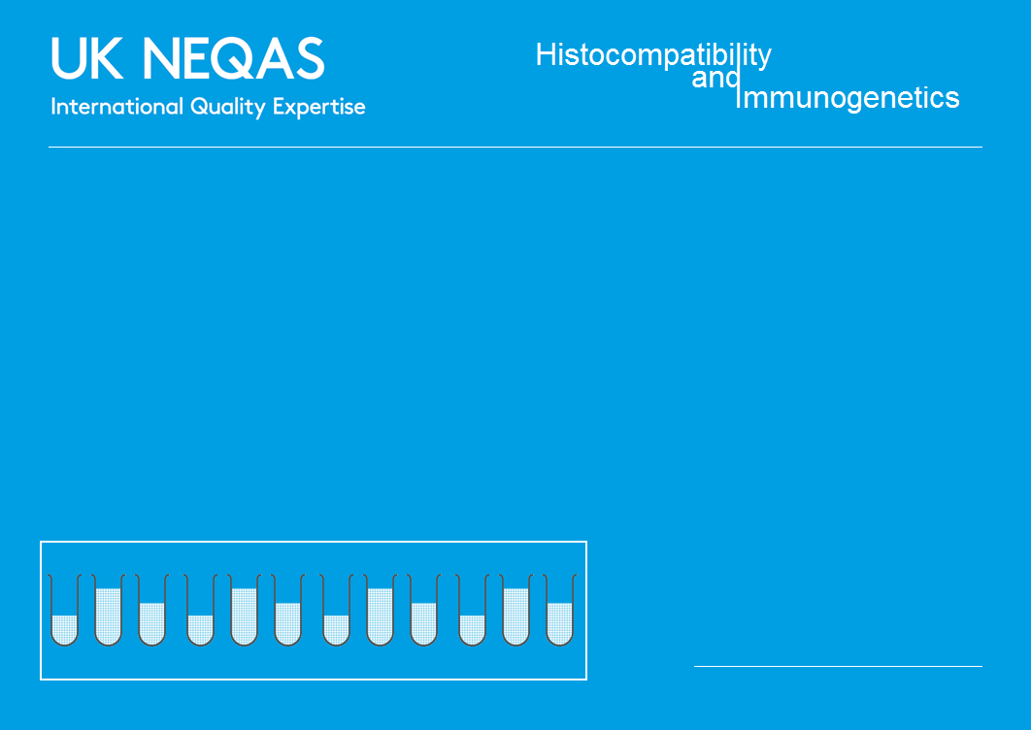
Educational Scheme Distribution
‘Donor’ Sample
1 x Whole Blood
‘Patient’ Samples
3 x Serum
HLA Typing
(Schemes 4A1&4A2)
Crossmatching
(Schemes 2A&2B)
Antibody Detection/ Specification
(Schemes 3&6)
PCR-SSP
PCR-SSO
CDC
ELISA
CDCXM
FCXM
SBT
Luminex
Clinical Interpretation
Transplant Risk Stratification

Slide 149
2018 Results
32 participants
  not all labs reported results for all tests
100% agreement on HLA type
  except DRB4 with some labs reporting absence or no result
 | A* | B* | C* | DRB1* | DRB4* | DQA1* | DQB1* | DPA1* | DPB1*
 | 24 | 45 | 06 | 04 | 01 | 02 | 02 | 01 | 01:01
 | 26 | 40 | 03 | 07 | - | 03 | 03 | 02 | 04:02
Number of reports | 32 | 32 | 30 | 32 | 21 | 25 | 31 | 13 | 17¹
% Labs in consensus | 100% | 100% | 100% | 100% | 76% | 100% | 100% | 100% | 100%

Slide 150
Serum 1 Results
 | Result | % Consensus | Comments
HLA Class I Antibodies | Positive | 84% | 5 labs reported negative (143, 190, 238, 260, 262)
HLA Class II Antibodies | Positive | 100%
DSA | Yes | 97% (28/29) | Huge range in MFI reported e.g. DR4 3,287-17,567 DSA included A24, Cw6, DR4, DR7, DQ8, DR53 and DQA
CDC XM | Negative | 100% (15/15)
FCXM T Cell | Not Assessed | 65.4% (17/26) | 65.4% positive, 34.6% negative
FCXM B Cell | Positive | 86.4% (19/23) | Lab 14, 112 reported negative, Lab 28, 54 reported equivocal
Transplant Risk | Contraindication/High | 62% (18/29) | 11 labs reported medium risk (9, 11, 24, 38, 48, 54, 62, 112, 149, 238, 262)

Slide 151
Serum 2 Results
 | Result | % Consensus | Comments
HLA Class I Antibodies | Positive | 100%
HLA Class II Antibodies | Positive | 100%
DSA | Yes | 96.6% (28/29) | Huge range in MFI reported e.g. DQ2 9,025-34,845 DSA included B45, DR7, DQ2, DQ8, DR53, DPB1*01:01, DPB1*04:02, DQA and DPA
CDC XM | B cell Positive T cell Negative | 100% (15/15) 92.3% (12/13) | PBL –DTT 80% Positive, +DTT Not Assessed (57% Positive)
FCXM T Cell | Negative | 84.6% (22/26) | 4 Labs reported Positive (Lab 11, 19, 20 and 38), 1 reported Equivocal (Lab 122)
FCXM B Cell | Positive | 100% (25/25)
Transplant Risk | Contraindication/High | 97% (28/29) | One Lab (195) reported medium risk

Slide 152
Serum 3 Results
 | Result | % Consensus | Comments
HLA Class I Antibodies | Positive | 94%
HLA Class II Antibodies | Positive | 100%
DSA | Yes | 86.2% (25/29) | DSA included A24, A26, B60, B45, Cw6, Cw10, DR4, DR7, DQ2, DQ8, DPB1*04:02, DQA and DPA
CDC XM | Negative | 100%
FCXM T Cell | Not Assessed | 66.7% (18/27) | 66.7% reported Negative, 33.3% Positive
FCXM B Cell | Not Assessed | 58.3% (14/24) | 58.3% reported Negative, 41.7% Positive
Transplant Risk | Medium Risk | 55% (16/29) | 5 labs reported a low risk (15, 23, 34, 39, 149, 194, 260), 3 a high risk (28, 48, 58) and 5 a contraindication (122, 162, 195, 220, 284)

Slide 153
Summary of Crossmatch and DSA Detection Results
2018 Results |  | Serum 1 |  | Serum 2 |  | Serum 3
DSA Defined by Luminex |  | Class I | Class II | Class I | Class II | Class I | Class II
MFI >10,000 |  | Cw6 (90%) |  |  | DR7 (28%) DQ2 (28%) DQ8 (22%) DR53 (19%) DQA1*02:01 (8%) DQA1*03:01 (2%) |  | DQ8 (25%)
MFI 5,000-9,999 |  |  | DR4 (97%) |  |  | A26 (9%)
MFI 3,000-4,999 |  |  |  | B45 (14%) | DPB1*01:01 (10%) DPB1*04:02 (16%) | B60 (15%) B45 (16%) | DPB1*04:02 (17%)
MFI 1,500-2,999 |  |  | DR7 (14%) DQ8 (14%) |  | DPA1*01:03 (1%) DPA1*02:01 (1%) | A24 (14%) | DPA1*01:03 (1%) DPA1*02:01 (1%) DQA1*03:01 (1%) DQA1*02:01 (1%) DQ2 (1%)
MFI <1,499 |  | A24 (14%) | DR53 (3%) DQA1*03 (3%) |  |  | Cw6 (2%) Cw10 (1%) | DR7 (2%) DR4 (1%)
CDCXM | No DTT | Negative |  | Positive |  | Negative
 | DTT | Negative |  | Negative (T cell) / Positive (B cell) |  | Negative
FCXM | T Cell | Not Assessed |  | Negative |  | Not Assessed
 | B Cell | Positive |  | Positive |  | Not Assessed
Risk |  | Contraindication/High (62%) |  | Contraindication/High (97%) |  | Medium (55%)
The table shows the percentage of participants identifying a DSA and the most common MFI range it was reported in.
DSAs with high MFI values have a noticeable affect on FCXM results but seem to affect labs differently in terms of the CDCXM

Slide 154
Benefits
Participants able to:
  Monitor performance of multiple techniques within a single scheme
  Make clinical interpretations based on their own results
  Compare local policies for clinical assessment
Educational
  Monitor concordances
  Review variations
  Trainees
Competency
  Laboratory staff
  Consultants

Slide 155
Future Considerations
Could the scheme form the basis of future formal EQA scheme design?
Workload
  Participants
  UK NEQAS
Assessment complexity
  Consensus?
  Incorrect result, correct interpretation?

Slide 156
Interpretive
Educational Schemes
Tracey Rees
Notes:
156

Slide 157
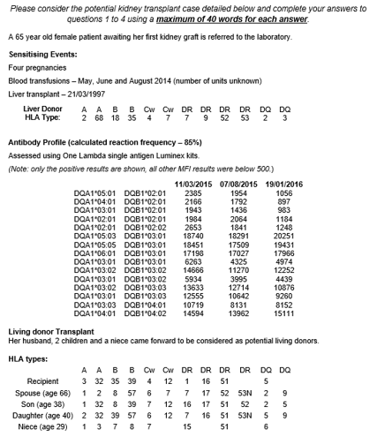
Interpretive Educational Scheme
3 Clinical Scenarios a year
  Solid Organ, HSCT, Platelet/transfusion
Based on patient cases
  Provide relevant clinical details and test results
  Questions on interpretation of results and clinical advice
Not Assessed
Provided free of charge
Notes:
157

Slide 158
Clinical Scenarios
 | Solid Organ | HSCT | Platelet/ transfusion
2013 | Live kidney transplant | Matched unrelated donor selection | N/A
2014 | Deceased kidney transplant | Mismatched unrelated donor selection | N/A
2015 | Cardiothoracic transplant | Paediatric cord blood donor selection | Platelet refractory
2016 | Deceased donor virtual XM | Donor search for patient with unusual HLA type | Platelet refractory
2017 | Cardiothoracic transplant | Haploidentical donor selection | TRALI
2018 | Live kidney transplant | Unrelated donor selection permissive/non-permissive | NAIT

Slide 159
Scenario 1- Kidney Transplant Case
Offer of kidney transplant to your centre and selection of recipients
Provided
  Patient HLA type and ABO (O)
  HLA antibody profile
  Information on potential recent sensitising events
  Crossmatching results
53 returns (22 UK&I)

Slide 160
Would you recommend removing antibodies from the patient’s profile?
HLA Antigen | 01/2018 | 08/2017 | 02/2017 | 10/2016
A1 | 1105 | 793 | 1964 | 2697
A2 | 13071 | 12308 | 16756 | 18994
A23 | 654 | 922 | 1928 | 2640
A24 | 1062 | 1174 | 2138 | 1436
A69 | 721 | 1900 | 2015 | 2671
B44 | 1474 | 2413 | 2691 | 3248
B45 | 1369 | 1598 | 3365 | 4535
B13 | 1021 | 1845 | 2031 | 4461
B62 | 9204 | 6273 | 8333 | 10091
B63 | 1574 | 1308 | 3327 | 4112
B75 | 1246 | 1673 | Negative | 4238
B76 | 3675 | 3118 | 4494 | 6852
B77 | Negative | Negative | 1135 | 3241
B38 | Negative | Negative | 1340 | 1507
B39 | 1060 | 779 | 1395 | 1564
B57 | 12405 | 14011 | 18987 | 17756
B58 | 12008 | 11179 | 16947 | 17581
B49 | 6705 | 5387 | 5899 | 5698
B50 | 4752 | 5089 | 6357 | 6028
B27 | 1005 | 1062 | Negative | Negative
B37 | 753 | 734 | 1379 | 1480
B41 | 5447 | 4968 | 5724 | 6937
B42 | 4218 | 3882 | 4185 | 4953
B55 | 2748 | 1540 | 2938 | 3337
B56 | 4619 | 4233 | 4703 | 4422
B59 | 1531 | Negative | 1135 | 1453
B67 | 3581 | 1890 | 4020 | 4321
B71 | 3168 | 2692 | 1960 | 1402
B72 | 7033 | 4305 | 4958 | 4510
Cw5 | 18465 | 18445 | 18993 | 18914
DR1 | 7298 | 6877 | 9665 | 12792
DR15 | 650 | Negative | Negative | Negative
DR16 | 775 | Negative | Negative | Negative
DR7 | 2580 | 2243 | 2330 | 4856
DR8 | Negative | Negative | 5006 | Negative
DR9 | 3335 | 2728 | 3939 | 4590
DR10 | 2128 | 1709 | 2301 | 4291
DR103 | 6777 | 6717 | 9568 | 12323
DR51 | 4980 | 4367 | 6671 | Negative
The patient currently has a cRF of 99%
94% recommended delisting antibodies. Reasons included:
  Temporal changes in ab level
  Some ab likely transfusion derived
  Increase threshold for listing to >3,000 as equates to a positive FCXM
  Delist from one loci at a time
  Only if patient medically fit to receive enhanced immunosuppression
  Perform C1q assay
  Remove only CDC negative ab
  Only include pregnancy derived ab as UAG
Decision | UK&I |  | RoW |  | Total
 | Number | Percentage | Number | Percentage | Number | Percentage
Yes | 22/22 | 100% | 28/31 | 90% | 50/53 | 94%
No | 0/22 | 0% | 3/31 | 10% | 3/53 | 6%

Slide 161
Select Antibodies for Delisting
HLA Antigen | 01/2018 | 08/2017 | 02/2017 | 10/2016
A1 | 1105 | 793 | 1964 | 2697
A2 | 13071 | 12308 | 16756 | 18994
A23 | 654 | 922 | 1928 | 2640
A24 | 1062 | 1174 | 2138 | 1436
A69 | 721 | 1900 | 2015 | 2671
B44 | 1474 | 2413 | 2691 | 3248
B45 | 1369 | 1598 | 3365 | 4535
B13 | 1021 | 1845 | 2031 | 4461
B62 | 9204 | 6273 | 8333 | 10091
B63 | 1574 | 1308 | 3327 | 4112
B75 | 1246 | 1673 | Negative | 4238
B76 | 3675 | 3118 | 4494 | 6852
B77 | Negative | Negative | 1135 | 3241
B38 | Negative | Negative | 1340 | 1507
B39 | 1060 | 779 | 1395 | 1564
B57 | 12405 | 14011 | 18987 | 17756
B58 | 12008 | 11179 | 16947 | 17581
B49 | 6705 | 5387 | 5899 | 5698
B50 | 4752 | 5089 | 6357 | 6028
B27 | 1005 | 1062 | Negative | Negative
B37 | 753 | 734 | 1379 | 1480
B41 | 5447 | 4968 | 5724 | 6937
B42 | 4218 | 3882 | 4185 | 4953
B55 | 2748 | 1540 | 2938 | 3337
B56 | 4619 | 4233 | 4703 | 4422
B59 | 1531 | Negative | 1135 | 1453
B67 | 3581 | 1890 | 4020 | 4321
B71 | 3168 | 2692 | 1960 | 1402
B72 | 7033 | 4305 | 4958 | 4510
Cw5 | 18465 | 18445 | 18993 | 18914
DR1 | 7298 | 6877 | 9665 | 12792
DR15 | 650 | Negative | Negative | Negative
DR16 | 775 | Negative | Negative | Negative
DR7 | 2580 | 2243 | 2330 | 4856
DR8 | Negative | Negative | 5006 | Negative
DR9 | 3335 | 2728 | 3939 | 4590
DR10 | 2128 | 1709 | 2301 | 4291
DR103 | 6777 | 6717 | 9568 | 12323
DR51 | 4980 | 4367 | 6671 | Negative
HLA Spec | Number of labs agreeing to remove Spec (n=50)
 | Total | UK&I | RoW
A1 | 41 | 20 | 21
A2 | 1 | 0 | 1
A23 | 39 | 19 | 20
A24 | 37 | 19 | 18
A69 | 36 | 17 | 19
B27 | 6 | 1 | 5
B37 | 7 | 1 | 6
B38 | 5 | 1 | 4
B39 | 7 | 1 | 6
B42 | 4 | 2 | 2
B44 | 10 | 4 | 6
B45 | 16 | 8 | 8
B49 | 2 | 0 | 2
B50 | 1 | 0 | 1
B56 | 5 | 2 | 3
B58 | 1 | 0 | 1
B59 | 6 | 1 | 5
B13 | 27 | 16 | 11
B62 | 1 | 0 | 1
B63 | 22 | 14 | 8
B67 | 5 | 2 | 3
B71 | 3 | 1 | 2
B72 | 1 | 0 | 1
B75 | 27 | 18 | 9
B77 | 27 | 15 | 12
B55 | 14 | 4 | 10
Cw5 | 1 | 0 | 1
DR7 | 12 | 4 | 8
DR8 | 30 | 16 | 14
DR9 | 7 | 2 | 5
DR1 | 1 | 0 | 1
DR10 | 13 | 5 | 18
DR15 | 33 | 14 | 19
DR16 | 34 | 15 | 19
DR51 | 9 | 4 | 5
The most frequency chosen antibodies for delisting are A1, A24, A24, A69, DR15 and DR16

Slide 162
Would you perform additional testing or give recommendations to increase the chance of deceased donor transplantation?
Decision | UK&I |  | RoW |  | Total
 | Number | Percentage | Number | Percentage | Number | Percentage
Yes | 20/22 | 91% | 28/31 | 90% | 48/53 | 91%
No | 2/22 | 9% | 3/31 | 10% | 5/53 | 9%
91% of respondents answered that they would perform additional testing. Examples of which included:
  EDTA treat serum samples
  Test using alternative method e.g. Lifecodes or C1q
  Perform 3rd party crossmatches
  Eplet study or HLA Matchmaker
  Consider live donor options
  Check ABO ab titres for ABOi transplant consideration
  Review local DCD/Fast Track local policy for priority allocation
  Plasma exchange/plasmapheresis
  Allow repeat mm to partner
  Perform an autologous crossmatch

Slide 163
Based on the results given what would you recommend?
Potential Donor | ABO | HLA type | Current CDC XM Result | Current FCXM Result
Niece | A | A2, A68; B44, B51; Cw5, Cw14; DR4, DR13; DQ6, DQ7 | PBL Positive (scored “6” with and without DTT) B cell Positive (scored “4” with and without DTT) | T Cell (LCS 232) B cell (LCS 264) Strong Positives
LCS = Linear Channel Shift (T Cell >46 = Pos) (B Cell >63 = Pos)
Recommendations:
  Discontinue transplant work up, high risk ABOi and HLAi
  Transplant veto as CDCXM and FCXM positive
  Perform autologous crossmatches, discuss at MDT meeting
  Repeat pregnancy haplotype mismatch with antibody, poor prognosis
  Patient unlikely to respond to desensitisation
  Enter pair into the Kidney Sharing Scheme

Slide 164
What antibody profile would you use to register the pair in the kidney sharing scheme?
 |  | UK&I (n=22) |  | RoW (n=31) |  | Total (n=53) | %
 |  | Number | Percentage | Number | Percentage
Option 1 | Same profile as original deceased donor profile | 0 | 0% | 4 | 13% | 4 | 8%
Option 2 | Modified deceased donor profile | 16 | 73% | 20 | 65% | 36 | 68%
Option 3 | Other | 6 | 27% | 7 | 22% | 13 | 24%
Registration with the a reduced UAG profile was the most popular option (68%). The reasons cited included:
  To increase the chances of getting a match
  Use a conservative approach and delist in subsequent matching runs
  Local policy is to list of ab with MFI >3,000
  Patient has limited vascular access, may need to take additional risks and delist further
  Option to use pre and post transplant desensitisation

Slide 165
Predict the CDCXM and FCXM result for the new donor
Some antigens were removed from the patient’s unacceptable antigen profile and a match was identified in the kidney sharing scheme (mm in red, patient DP type unknown)
ABO O | A1, A24; B8, B51; Cw1, Cw7; DR11, DR17; DR52; DQ2, DQ7; DPB1*02:01, -
 | Predicted Crossmatch Result
 | Positive |  |  | Negative |  |  | Other
 | UK&I | RoW | Total | UK&I | RoW | Total | UK&I | RoW | Total
CDC | 0 | 0 | 0 | 22 | 30 | 32 | 0 | 0 | 0
Flow Cytometry | 1 | 5 | 6 | 11 | 17 | 28 | 10 | 8 | 18
Most respondents predict the CDCXM and FCXM will be negative.
The reasons cited included:
  Cumulative DSA MFI not expected to cause a positive result
  Possible historic positive, current negative crossmatch
  Patient has A1 and A24 DSA these antigens don’t share any antibody-verified eplet with the sensitising event ab
  Wet crossmatch recommended

Slide 166
A crossmatch is performed. What level of immunological risk would you assign this transplant?
Serum Sample | 03/2018 | 01/2018 | 08/2017 | 02/2017 | 10/2016
Donor directed antibody | A1, 24 | A1, 24 | A1, 24 | A1, 24 | A1, 24
Cumulative MFI of DSA | 2867 | 2167 | 1967 | 4102 | 4133
LCS T cells (>46 = Pos) | 40.1 | 38.1 | 35.6 | 68.1 | 88.2
LCS B cells (>63 = Pos) | 58.5 | 59.7 | 55.5 | 71.1 | 82.1
FCXM result | T cell Neg B cell Neg | T cell Neg B cell Neg | T cell Neg B cell Neg | T cell Pos B cell Pos | T cell Pos B cell Pos
CDC XM result | Negative | Negative | Negative | Negative | Negative
LCS = Linear Channel Shift
Most respondents stated this would be a Intermediate risk transplant.
The reasons cited included:
  Following BTS/BSHI Guidelines
  Current negative, historic positive crossmatch, low level DSA
 | UK&I (n=22) |  | RoW (n=30) |  | Total (n=52) | %
 | Number | Percentage | Number | Percentage
Standard | 1 | 4% | 0 | 0% | 1 | 2%
Low | 3 | 14% | 4 | 13% | 7 | 13%
Intermediate | 18 | 82% | 20 | 67% | 38 | 73%
High | 0 | 0% | 5 | 17% | 5 | 10%
Contraindication | 0 | 0% | 1 | 3% | 1 | 2%
Other | 0 | 0% | 0 | 0% | 0 | 0%

Slide 167
A crossmatch is performed on a 2nd donor. What level of immunological risk would you assign this transplant?
ABO O | A1, A3; B7, B44; Cw7, -; DR4, -; DR53; DQ7, DQ9; DPB1*04:01, -
Serum Sample | 03/2018 | 01/2018 | 08/2017 | 02/2017 | 10/2016
Donor directed antibody | A1, B44 | A1, B44 | A1, B44 | A1, B44 | A1, B44
Cumulative MFI of DSA | 2901 | 2579 | 3206 | 4655 | 5945
LCS T cells (>46 = Pos) | 39.3 | 36.1 | 69.6 | 83.9 | 92.2
LCS B cells (>63 = Pos) | 58.5 | 55.7 | 68.4 | 78.6 | 84.3
FCXM result | T cell Neg B cell Neg | T cell Neg B cell Neg | T cell Pos B cell Pos | T cell Pos B cell Pos | T cell Pos B cell Pos
CDC XM result | Negative | Negative | Negative | Negative | Negative
LCS = Linear Channel Shift
 | UK&I (n=22) |  | RoW (n=30) |  | Total (n=52) | %
 | Number | Percentage | Number | Percentage
Standard | 0 | 0% | 1 | 3% | 1 | 2%
Low | 0 | 0% | 2 | 7% | 2 | 4%
Intermediate | 18 | 82% | 16 | 53% | 34 | 65%
High | 2 | 9% | 8 | 27% | 10 | 19%
Contraindication | 0 | 0% | 1 | 3% | 1 | 2%
Other | 2 | 9% | 2 | 7% | 4 | 8%

Slide 168
What level of immunological risk would you assign this transplant?
Most respondents stated this would be a Intermediate risk transplant.
The reasons cited included:
  BSHI/BTS Guidelines categorise historic positive current negative T/B cell FCXM (CDCXM negative) due to current IgG class I DSA as intermediate risk.
  The risk of hyperacute rejection is low. However risk of accelerated antibody mediated rejection due to memory response is higher due to historically positive Flow crossmatch.
  DSA is due to a known sensitisation event, pregnancy.
  Transplant possible with augmented immunosuppression and post-transplant monitoring.
  Recent cumulative DSA is ~3,000MFI, historically ~6,000

Slide 169
What clinical advise would you give?
Most common answers included:
  BSHI/BTS Guidelines state transplant is recommended given the anticipated loss of vascular access
  Clinical caution with proactive use of immunosuppression and post-transplant monitoring
  Discuss with MDT if sufficient time to enter another cycle of the sharing scheme

Slide 170
Scenario 2 – HSCT Scenario
42 year old female with high-risk ALL
Blood group: O Rh Positive
CMV status: Negative
HLA Type:
  A*02:01, A*24:02; B*07:02, B*51:01; C*02:02, C*07:02;
  DRB1*15:01, -; DQB1*06:02, -; DPB1*03:01, DPB1*04:01
Patient only has half-siblings
Unrelated donor search performed
37 responses received

Slide 171
Comment on the likelihood of finding a donor
Summary of responses from UK and Ireland (UK&I)
Likely to find a 10/10 matched donor
There is a high likelihood of finding a matched unrelated donor - although maybe not an optimal donor for non-HLA reasons as the number found would be quite small. Would be a challenging search due to rare/intermediate B/C association and homozygous DRB1/DQB1.
HLA-B*51:01 is associated with several different HLA-C alleles (e.g. C*01:02, C*14:02, C*15:02 and C*16:02) and is less frequently associated with C*02:02, making it less likely a 10/10 match will be found, particularly if registry HLA-C data is not provided.
HLA-C typing can be missing from some donors, this makes it difficult to predict if these donors are potentially fully matched or mismatched at HLA-C.
Summary of responses from Rest of World (RoW)
The haplotype A*02:01 C*02:02 B*07:02 DRB1*15:01 DQB1*06:02 is not very frequent and it could represent a challenge in donor search.
The patient has a frequent HLA haplotype found in Caucasian populations with high probability to find an identical HLA 10/10 donor. The difficulty will be to find among the 30 donors 10/10 identified in the BMDW a rapidly available and CMV negative donor.
Identification of HLA matched unrelated donor could be challenging due to DRB1, -DQB1 homozygosity; HLA-B*51:01 that could be associated with different HLA-C alleles and therefore HLA-C allele MM could be expected.
The patient carries the variant HLA-B*51 that can be associated with several HLA-C alleles, but in this phenotypic context, the haplotype A24, B7, Cw7, DR15 and DQ6 is common.
Unusual HLA-B/C linkage disequilibrium (B*51:01/C*02:02): 8% (NMDP data for CAU ethnic code).

Slide 172
An Unrelated Donor Search is Performed
10 available donors were identified
Respondents were asked to select 3 donors
 |  |  |  |  |  |  | HLA genotype
ID | M/F | Age | Blood group | CMV | Weight (kg) | Donor register | A* | B* | C* | DRB1* | DQB1* | DPB1* | Donor Choice | Reason
A | F | 48 | A Rh Pos | Unknown | Unknown | UK | 02:01/01L 24:02/02L | 51:01 07:02/61/ 161N | 02:02 07:02 | 15:01 | 06:02/47/84/ 109/111/116/117/127 | -
B | F | 36 | A Rh pos | Positive | 65 | UK | 02, 24 | 51, 07 | 02, 07 | 15:01 | 06 | -
C | F | 36 | Unknown | Negative | 98 | UK | 02, 24 | 51, 07 |  | 15:01 | 06:02 | -
D | M | 24 | Unknown | Unknown | 58 | UK | 02;01 24:02 | 51:01 07:02 | 07:02 14:02 | 15:01 | 06:02 | -
E | M | 28 | O Rh neg | Negative | Unknown | UK | 02, 24 | 51, 07 | 07, 15:44 | 15:01 | 06 | 04:01/ 126:01
F | F | 33 | O Rh pos | Positive | Unknown | German | 02:01 24:02 | 51:01 07:02 | 02:02 07:02 | 15:01 | 06:02 | 04:01 15:01 | 3rd (27%) | female., CMV positive, if transplant urgent give fully typed donors priority
G | M | 31 | O Rh pos | Negative | 73 | French | 02:01 24:02 | 51:01 07:02 | 02:02 07:02 | 15:01 | 06:02 | - | 1st (89%) | 10/10, CMV & ABO match, Young male, reliable registry
H | M | 31 | Unknown | Unknown | Unknown | German | 02, 24 | 51, 07 |  | 15:01 | 06:02 | - | 3rd (22%) | Young male, likely HLA match
I | F | 33 | A Rh pos | Unknown | Unknown | US | 02:01 24:02 | 51:01 07:02 | 02:02 07:02 | 15:01 | 06:02 | 02:01 03:01 | 1st (8%) 2nd (51%) | DPB permissive, 11/12 match, donor age, female to female, CMV unknown
J | M | 55 | Unknown | Negative | Unknown | German | 2, 24 | 51, 7 | 2, 7 | 15:01 | 06:02 | - | 2nd (13.5%) | 10/10 low resolution, CMV match, male, reliable registry

Slide 173
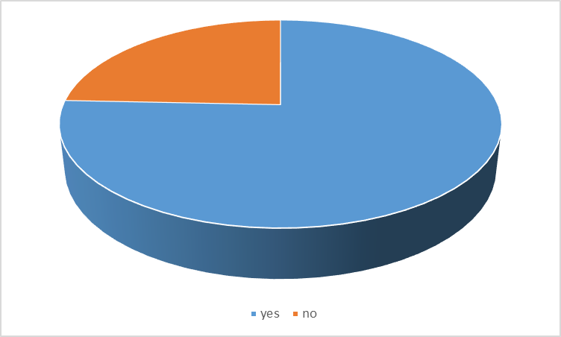
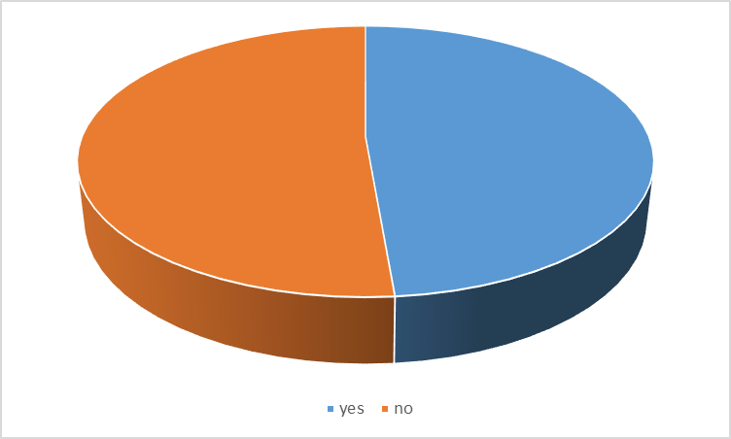
Does your laboratory test for HLA-DPB1 for HSCT patients and donors?
Most respondents stated they do perform DPB1 HLA typing.
Yes 76% (UK&I 67%), No 24% (UK&I 33%)
The reasons cited included:
  To get the best 12/12 match to see if permissive or non-permissive
  Routinely performed on all patients/donors but not used for donor selection/ranking unless a choice of well matched donors
  Aid to decide between well matched donors
  Published data on better outcomes for DPB permissive mismatch
  Only if DP antibodies are detected in the patient
  Not currently requested by clinicians
Does your Lab report permissive/non-permissive DPB1 mismatch information?
Yes 49% (UK&I 40%), No 51% (UK&I 60%)

Slide 174
Using the additional information, rank donor K, L and M in order of preference and outline reasons
Donor Ref | Gender | Age | ABO matched/ mismatched | HLA-DPB1 | Predicted Immunogenicity | Most common donor choice | Reason for selection
K | M | 31 | O Rh pos | 09:01 13:01 | Non-permissive HvG | 2nd choice (51%) | Young male donor, ABO match preferred despite non-permissive mm
L | F | 36 | O Rh pos | 05:01 13:01 | Non-Permissive GvH | 3rd choice (60%) | ABO match, older female (poss pregnancies), non-permissive GvH with possible GvL effect, increased risk of GvHD
M | F | 33 | A Rh pos | 02:01 03:01 | Permissive | 1st choice (73%) | Young donor, 11/12, permissive, ABO mm

Slide 175
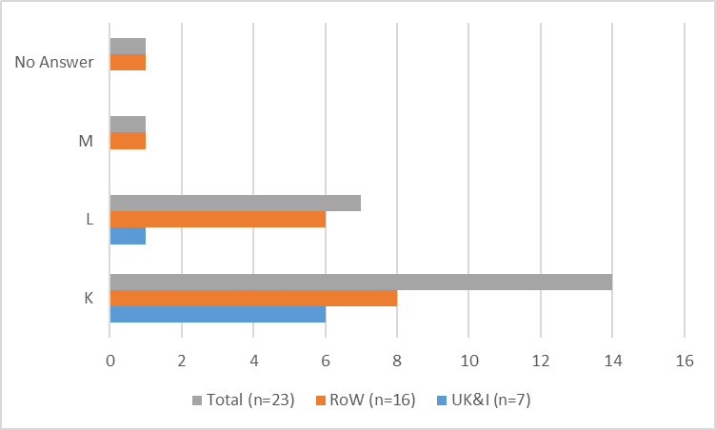
Does additional antibody screening data change your donor selection?
Antibody data provided (Potential DSAs):
HLA Allele | Specificity | MFI |  | HLA Allele | Specificity | MFI
DQB1*04:02 | DQ4 | 24780 |  | DRB1*12:02 | DR12 | 14773
DQB1*04:01 | DQ4 | 24455 |  | DPB1*02:01 | DP2 | 6428
DQB1*03:01 | DQ7 | 22994 |  | DPB1*18:01 | DP18 | 4857
DQB1*03:01 | DQ7 | 20935 |  | DPB1*13:01 | DP13 | 2532
DQB1*03:01 | DQ7 | 20854 |  | DPB1*06:01 | DP6 | 2464
DQB1*04:02 | DQ4 | 20158 |  | DPB1*13:01 | DP13 | 2385
DQB1*03:01 | DQ7 | 18905 |  | DPB1*14:01 | DP14 | 2086
DQB1*04:01 | DQ4 | 17499 |  | DPB1*13:01 | DP13 | 1986
DRB1*11:04 | DR11 | 15762 |  | DPB1*20:01 | DP20 | 1796
DRB1*12:01 | DR12 | 15458 |  | DPB1*17:01 | DP17 | 1432
DRB1*11:01 | DR11 | 14865 |  | DPB1*06:01 | DP6 | 1305
Yes 62% (UK&I 47%), No 33% (UK&I 47%)
No response 5% (6%)
If yes, which donor would now be your first choice?
Most respondents stated they would now select donor K (61%) as first choice due to lower MFI of potential DSAs, ABO match and DP permissive.

Slide 176
Scenario 3 – Neonatal Alloimmune Thrombocytopenia (NAIT)
A suspected case of NAIT is referred for investigation.
Maternal platelet count
HPA type of mother, father and child
Indirect MAIPA results
24 responses received (11 UK&I)

Slide 177
Comment on the likelihood of NAIT, transfusion advice and potential risk to subsequent pregnancies
Question | Response | Total (n=24)
Likelihood of NAIT | Highly Likely | 14 (56%)
 | Likely | 11 (44%)
Defined antibody | HPA-1a antibody | 18 (90%)
 | HPA-3a antibody | 1 (5%)
 | HPA-5b antibody | 1 (5%)
Transfusion Advice | HPA-1a negative platelets | 18 (75%)
 | HPA-1a and 5a negative platelets | 6 (25%)
Risk to Subsequent Pregnancies | Yes | 22 (100%)
Patient Management in Subsequent Pregnancies | Maternal IVIg | 17 (34%)
 | Foetal HPA Typing | 16 (32%)
 | Ultrasound monitoring | 5 (10%)
 | Monitor Maternal HPA antibody levels | 4 (8%)
 | Caesarean | 3 (6%)
 | Transfuse HPA-1a negative platelets | 3 (6%)
 | Counselling | 1 (2%)
 | Transfuse HPA-1a 5b negative platelets | 1 (2%)
Donor Cell Panel HPA –Type | 1a, 1a 2b, 2b 3a, 3a 5b , 5b 15a, 15a | 1b, 1b 2a, 2a 3b, 3b 5a, 5a, 15b, 15b | 1a, 1a 2b, 2b 3a, 3a 5a, 5a 15b, 15b | 1b, 1b 2a, 2a 3b, 3b 5b, 5b 15a, 15a | 1a, 1b 2a, 2b 3a, 3b 5a, 5b 15a, 15b
GPIIb/IIIa PAB 1 | POS | N | POS | N
GPIa/IIa | N | N
GPIb/IX | N | N
HLA W6/32 + P43 |  |  |  |  | N
Mother - 1b:1b, 2a:2a, 3a:3b, 4a:4a, 5a:5a, 6a:6a, 9a:9a, 15a:15b
Father - 1a:1b, 2a:2b, 3a:3a, 4a:4a, 5b:5b, 6a:6a, 9a:9a, 15a:15b
Childs - 1a:1b, 2a:2a, 3a:3a, 4a:4a, 5a:5b, 6a:6a, 9a:9a, 15a:15a
Most respondents agreed that NAIT was highly likely, due to a HPA-1a antibody.
Advice would be to transfuse HPA-1a neg platelets. Subsequent pregnancies are at risk and treatment should be with IVIg.

Slide 178
Comment on the likelihood of NAIT, transfusion advice and potential risk to subsequent pregnancies
A further case was referred to the lab
Donor Cell Panel HPA –Type | 1a, 1a 2b, 2b 3a, 3a 5b, 5b 15a, 15b | 1a, 1a 2a, 2a 3b, 3b 5a, 5a 15a, 15b | 1b, 1b 2b, 2b 3a, 3a 5a, 5a 15a, 15b | 1b, 1b 2a, 2a 3b, 3b 5b, 5b 15a, 15a | 1a, 1b 2a, 2b 3a, 3b 5a, 5b 15b, 15b
GPIIb/IIIa
GPIa/IIa
GPIb/IX
HLA W6/32 + P43
CD109
Question | Response | Total (n=24)
Consistent with NAIT | Yes | 23 (96%)
 | Unclear | 1 (4%)
Reason | HPA-3a antibody | 24 (60%)
 | HPA-15b antibody | 16 (40%)
Transfusion Advice | HPA-3a negative platelets | 11 (46%)
 | HPA-3a 15b negative platelets | 6 (25%)
 | HPA-1a and 5b negative platelets | 3 (12.5%)
 | Transfuse with maternal platelets | 3 (12.5%)
 | HPA-3b 15b platelets | 1 (4%)
Risk to Subsequent Pregnancies | Yes | 22 (92%)
 | Undetermined | 2 (8%)
Patient Management in Subsequent Pregnancies | Maternal IVIg | 16 (47%)
 | Close monitoring/desensitisation | 6 (17%)
 | Monitor Maternal HPA antibody levels | 4 (12%)
 | Foetal HPA Typing | 4 (12%)
 | Ultrasound monitoring | 3 (9%)
 | Caesarean | 1 (3%)
Mother - 1a:1b, 2a:2a, 3b:3b, 4a:4a, 5a:5a, 6a:6a, 9a:9a, 15a:15a
Father - 1a:1a, 2a:2b, 3a:3a, 4a:4a, 5a:5b, 6a:6a, 9a:9a, 15a:15b
Child - 1a:1b, 2a:2a, 3a:3b, 4a:4a, 5a:5a, 6a:6a, 9a:9a, 15a:15a
Most respondent agreed this case was NAIT, due to a HPA-3a antibody.
Advice would be to transfuse HPA-3a neg platelets. Subsequent pregnancies are at risk and treatment should be with IVIg.

Slide 179
Comment on the likelihood of NAIT, transfusion advice and potential risk to subsequent pregnancies
A further case was referred to the lab
Donor Cell Panel HPA –Type | 1a, 1a 2b, 2b 3a, 3a 5b, 5b 15a, 15b | 1a, 1a 2a, 2a 3b, 3b 5a, 5a 15a, 15b | 1b, 1b 2b, 2b 3a, 3a 5a, 5a 15a, 15b | 1b, 1b 2a, 2a 3b, 3b 5b, 5b 15a, 15b | 1a, 1b 2a, 2b 3a, 3b 5a, 5b 15a, 15b
GPIIb/IIIa
GPIIb/IIIa Alt.Mabs: PAB5
GPIa/IIa
GPIb/IX
HLA W6/32 + P43
CD109
Question | Response | Total (n=24)
Consistent with NAIT | Yes | 11 (44%)
 | Unclear | 9 (36%)
 | No | 5 (20%)
Reason | GPIIb/IIIa antibody | 19 (42%)
 | Autoantibodies (ITP) | 8 (18%)
 | Possible Glanzmann’s Thrombasthenia | 7 (16%)
 | HPA-5b antibody not detected | 4 (9%)
 | HPA-5b mismatch | 4 (9%)
 | HPA-5b antibody detected | 2 (4%)
 | HPA-3a antibody detected | 1 (2%)
Transfusion Advice | Transfuse random donor platelets | 10 (29%)
 | Do not transfuse | 5 (14.5%)
 | IVIg | 5 (14.5%)
 | Maternal platelets | 4 (12%)
 | Crossmatch mother and father | 3 (9%)
 | HPA-1a and 5b negative platelets | 3 (9%)
 | Monitor neonatal platelet count | 1 (3%)
 | HLA matched platelets | 1 (3%)
 | HPA-3a negative platelets | 1 (3%)
 | Use medication to increase clotting | 1 (3%)
Mother - 1a:1b, 2a:2a, 3a:3b, 4a:4a, 5a:5a, 6a:6a, 9a:9a, 15a:15b
Father - 1a:1a, 2a:2b, 3a:3a, 4a:4a, 5a:5b, 6a:6a, 9a:9a, 15a:15b
Child - 1a:1b, 2a:2a, 3a:3a, 4a:4a, 5a:5b, 6a:6a, 9a:9a, 15a:15a
Most respondents agreed this case was NAIT, due to a GPIIb/IIIa antibody.
Advice would be to transfuse with random donor platelets.

Slide 180
What tests would you recommend for this case and why?
A further case was referred to the lab
Donor Cell Panel HPA –Type | 1a, 1a 2b, 2b 3a, 3a 5b, 5b 15a, 15b | 1a, 1a 2a, 2a 3b, 3b 5a, 5a 15a, 15b | 1b, 1b 2b, 2b 3a, 3a 5a, 5a 15a, 15b | 1b, 1b 2a, 2a 3b, 3b 5b, 5b 15a, 15b | 1a, 1b 2a, 2b 3a, 3b 5a, 5b 15a, 15b
GPIIb/IIIa
GPIIb/IIIa Alt.Mabs: PAB5
GPIa/IIa
GPIb/IX
HLA W6/32 + P43
CD109
Question | Response | Total (n=24)
Further test | CD109 MAIPA | 14 (22.5%)
 | HPA typing | 11 (18%)
 | Crossmatch | 7 (11%)
 | Enquire whether mother used egg donor | 5 (8%)
 | Use extended panel MAIPA | 4 (6%)
 | Re-test after 4-6 weeks | 4 (6%)
 | Repeat MAIPA | 4 (6%)
 | Repeat MAIPA at double volume | 3 (5%)
 | Luminex screen for HLA antibodies | 3 (5%)
 | PIFT | 3 (5%)
 | Luminex screen for HPA antibodies | 2 (3%)
 | Investigate non-immune causes | 2 (3%)
 | Repeat MAIPA with dilute serum | 1 (1.5%)
Reason | HPA types do not suggest inheritance | 6 (40%)
 | HPA-15 mismatch | 6 (40%)
 | HPA-15a alloantibody | 3 (20%)
Immediate Transfusion Advice | HPA-15a negative platelets | 7 (26%)
 | Transfuse random donor platelets | 4 (15%)
 | HPA-5a 15b negative platelets | 3 (11%)
 | HPA-1a 5b negative platelets | 3 (11%)
 | Washed maternal platelets | 2 (7.5%)
 | IVIg | 2 (7.5%)
 | HLA matched platelets | 2 (7.5%)
 | HPA-5b negative platelets | 1 (3.6%)
 | Crossmatch mother and father | 1 (3.6%)
 | HPA-5b 15a negative platelets | 1 (3.6%)
 | Maternal HPA matched platelets | 1 (3.6%)
Mother - 1a:1b, 2a:2a, 3a:3b, 4a:4a, 5a:5a, 6a:6a, 9a:9a, 15b:15b
Child - 1a:1b, 2a:2a, 3a:3a, 4a:4a, 5a:5b, 6a:6a, 9a:9a, 15a:15a
Most respondents would perform a CD109 MAIPA due to a HPA-15 mm.
Advice would be to transfuse with HPA-15a negative platelets.

Slide 181
What tests would you recommend for this case and why? What transfusion advice would you provide?
A further case was referred to the lab maternal platelet count is 202 x 109/L, neonatal platelet count is 16 x 109/L, 38 weeks’ gestation. MAIPA is negative.
Question | Response | Total (n=24)
Further test | Crossmatch (PIFT or MAIPA) | 14 (22%)
 | Repeat MAIPA with extended panel | 11 (17%)
 | Repeat MAIPA (double volume sera) | 8 (12%)
 | Luminex HPA antibody screen | 7 (11%)
 | Repeat test after 4-6 weeks | 6 (9%)
 | HLA antibody screen | 5 (8%)
 | HLA-DRB3 type mother | 4 (6%)
 | Indirect PIFT | 3 (4.5%)
 | HLA Typing | 2 (3%)
 | Type for other platelet antigens | 2 (3%)
 | Retest with dilute serum | 1 (1.5%)
 | Refer to reference lab | 1 (1.5%)
 | CD109 MAIPA | 1 (1.5%)
Reason | Rare low titre antibody | 4 (24%)
 | Determine likelihood of HPA-1a alloimmunisation by DRB3 association | 2 (12%)
 | MAIPA not sensitive enough | 2 (12%)
 | Expression levels vary on platelets | 1 (5.7%)
 | Non-immune condition causing low platelet count | 1 (5.7%)
 | IgM blocking antibody present | 1 (5.7%)
 | Competition for binding site if antibody concentration high | 1 (5.7%)
 | Potential HPA-1a incompatibility | 1 (5.7%)
 | HLA antibodies causing thrombocytopenia | 1 (5.7%)
 | Other platelet antigens can cause NAIT | 1 (5.7%)
 | Antibodies not always detected on delivery | 1 (5.7%)
 | Patient antibodies absorbed on platelets | 1 (5.7%)
Immediate Transfusion Advice | HPA-1a 5b negative platelets | 15 (52%)
 | Random donor platelets | 6 (21%)
 | HLA matched platelets | 2 (6.75%
 | HPA-1a negative platelets | 2 (6.75%)
 | IVIg | 2 (6.75%)
 | Washed maternal platelets | 2 (6.75%)
Mother - 1b:1b, 2a:2a, 3a:3b, 4a:4a, 5a:5a, 6a:6a, 9a:9a, 15a:15b
Father - 1a:1a, 2a:2b, 3a:3a, 4a:4a, 5b:5b, 6a:6a, 9a:9a, 15a:15b
Child - 1a:1b, 2a:2a, 3a:3a, 4a:4a, 5a:5b, 6a:6a, 9a:9a, 15a:15a
Most respondents would perform a PIFT or MAIPA crossmatch due to a potential rare low titre antibody.
Advice would be to transfuse with HPA-1a5b negative platelets.

Slide 182
What tests would you recommend for this case and why?
A further case from a South East Asian family was referred to the lab. The MAIPA result is negative but the PIFT is positive with the mother’s serum.
Question | Response | Total (n=24)
Further test | Crossmatch | 10 (21%)
 | GPIV/CD36 Typing/MAIPA | 8 (17%)
 | HLA antibody screening | 6 (12%)
 | Luminex HPA Antibody Screen | 5 (10%)
 | HLA Type | 4 (8%)
 | PIFT | 3 (6%)
 | HPA Type | 3 (6%)
 | NGS Sequencing | 3 (6%)
 | Investigate maternal auto-antibodies | 3 (6%)
 | Test for platelet disorder e.g. Glanzmann’s | 1 (2%)
 | MAIPA with reduced serum volume | 1 (2%)
 | Platelet counts | 1 (2%)
 | Non-immune investigations | 1 (2%)
Reason | CD36 clinically relevant in Asian populations | 8 (35%)
 | HLA Class I antibodies causing positive PIFT | 4 (18%)
 | Low frequency antibodies/antigens | 4 (18%)
 | Maternal auto-antibody | 3 (13%)
 | Anti-CD36 implicated in NAIT | 1 (4%)
 | Alloimmunisation to atypical HPA | 1 (4%)
 | Alloimmunisation to blood group antigens | 1 (4%)
 | Possible platelet disorder | 1 (4%)
Mother - 1a:1a, 2a:2a, 3a:3a, 4a:4a, 5a:5a, 6a:6a, 9a:9a, 15a:15b
Father - 1a:1a, 2a:2a, 3a:3a, 4a:4a, 5a:5a, 6a:6a, 9a:9a, 15a:15b
Child - 1a:1a, 2a:2a, 3a:3a, 4a:4a, 5a:5a, 6a:6a, 9a:9a, 15a:15b
Most respondents would perform a crossmatch as CD36 is clinically relevant in Asian populations.

Slide 183
iED Discussion
Questions / comments ?
  Ideas for cases
  Result feedback
  Format of cases
  Complexity level
  Educational benefit
  Number of questions

Slide 184
Educational Scheme: Interesting Result
Sample ED03/18 probable HLA type
HLA-A*02:01, A*29:02; B*44:03, B*44:221; C*05:01, C*16:01; DRB1*11:04, DRB1*15:01; DRB3*02; DRB5*01; DQB1*03:01, DQB1*06:02; DPB1*02:01, DPB1*04:01
10/39 (4/19 UK&I) labs correctly reported B*44:03, B*44:221
11/39 (6/19 UK&I) labs reported the correct type as part of a string e.g. B*44:02/03, B*44:221/258
6/39 (4/19 UK&I) labs reported B*44:02, B*44:258
2/39 (2/19 UK&I) labs reported B*44:02/221, B*44:03/258
Discrepancies in type caused by a cis/trans ambiguity
Allele 1 |  | Allele 2
Report | Number of Participants (n= 39) | Report | Number of Participants (n= 39)
B*44 homozygous | 8 (21%) | B*44 homozygous | 8 (21%)
B*44:02 | 6 (15%) | B*44:221 | 10 (26%)
B*44:03 | 10 (26%) | B*44:258 | 6 (15%)
B*44:02/03/… | 11 (28%) | B*44:221/258 | 11 (28%)
B*44:02/221 | 2 (5%) | B*44:03/258 | 2 (5%)
B*44:104 | 1 (2.5%) | B*44:224 | 1 (2.5%)
B*35:01 | 1 (2.5%) | B*38:01 | 1 (2.5%)

Slide 185
Thank you
Director: Dr Tracey Rees
Manager: Deborah Pritchard
Operations Manager: Amy De’Ath
Deputy Manager: Melanie Bartley
Healthcare Scientist Practitioner: Geraint Clarke
QA Officers: Luke Gardner & Lucy Palmer

